Slide 1
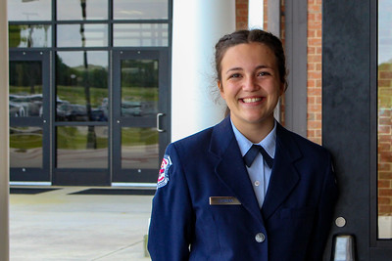
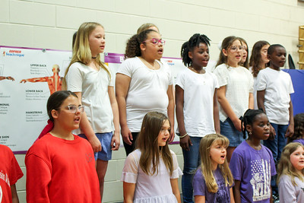
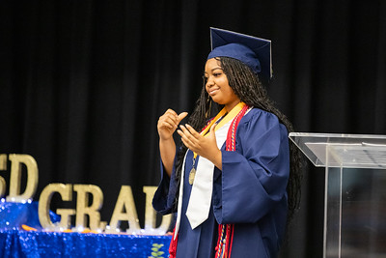
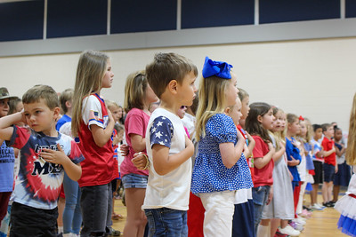
Spring Bootstrap 2025
Richard Woods
State School Superintendent

Slide 2
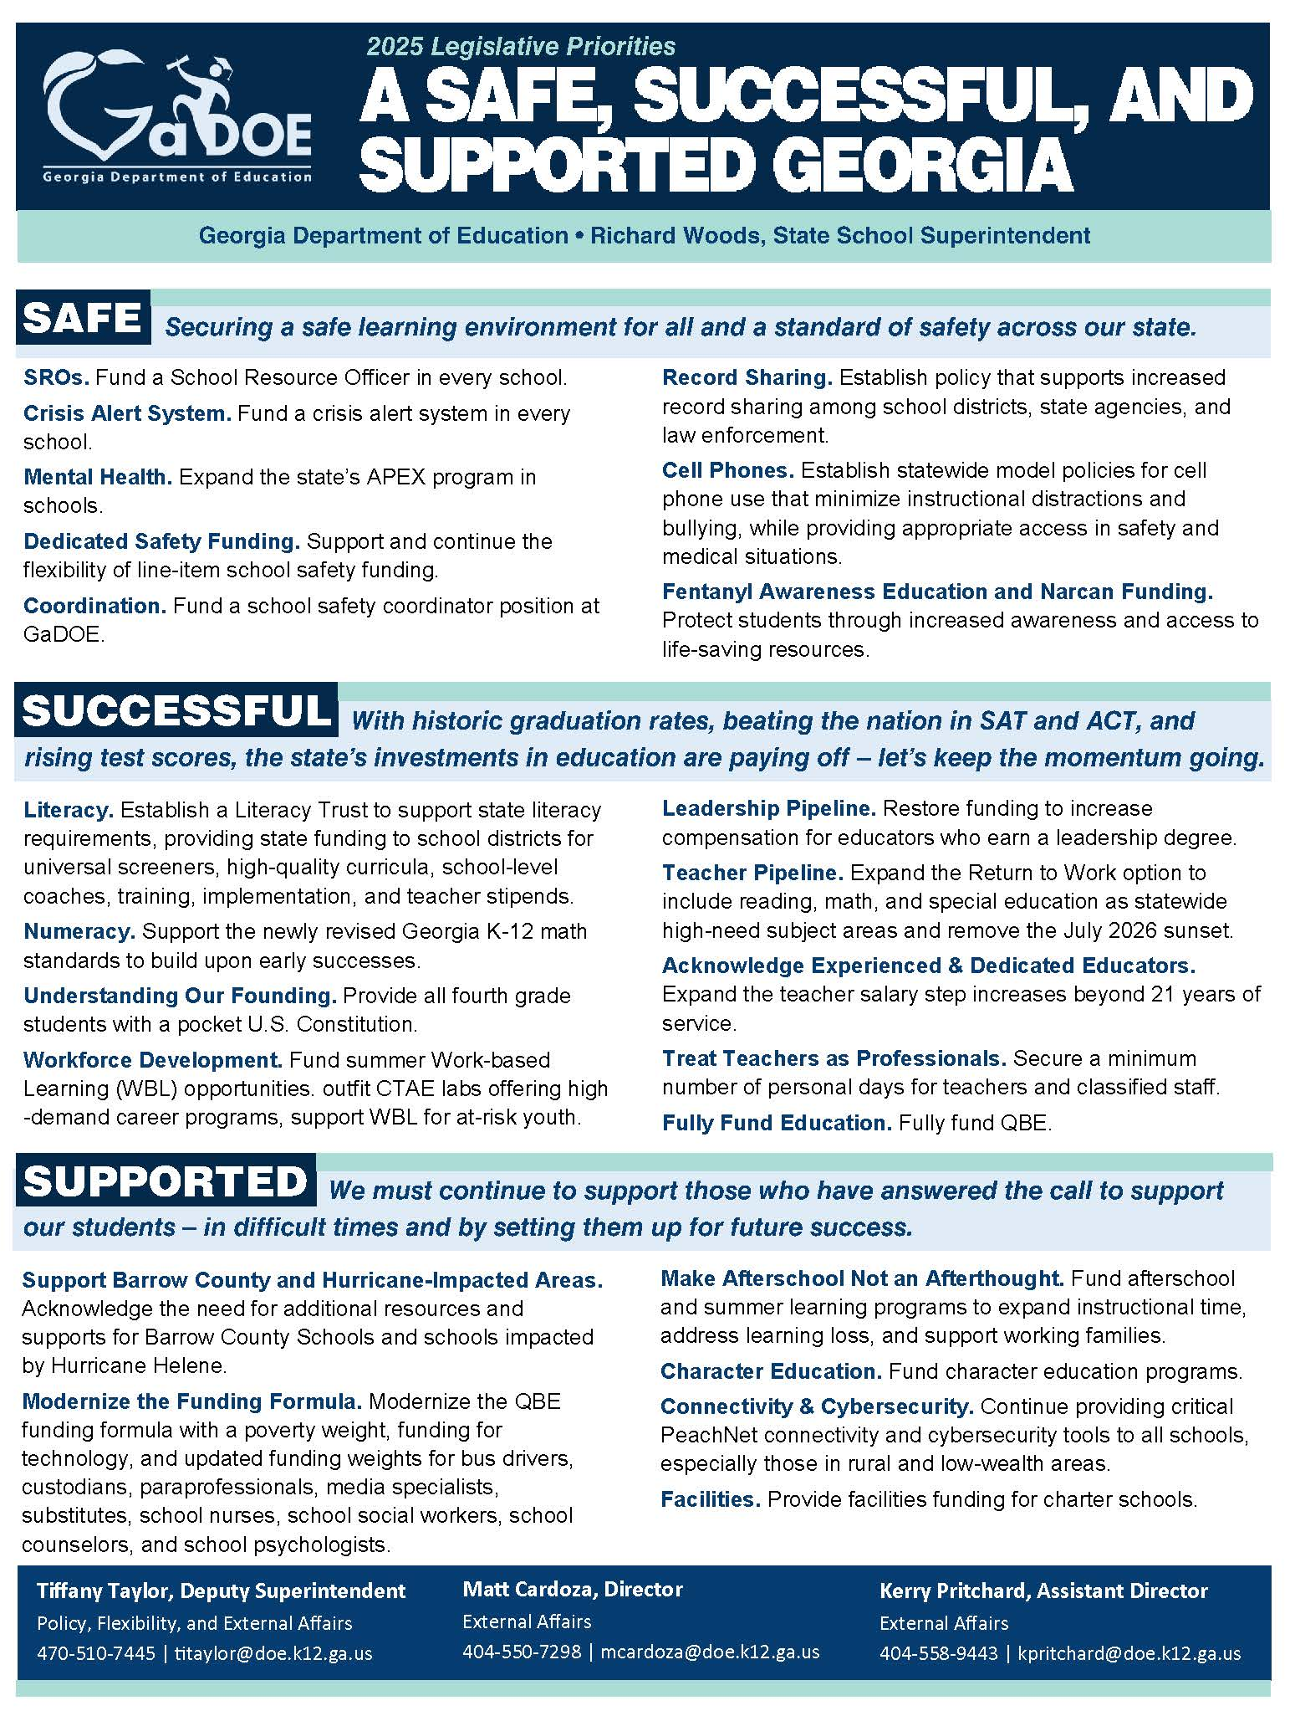
2025 Legislative Priorities: A Safe, Successful, and Supported Georgia
Thank you to the General Assembly and Governor Kemp for their support of public education.

Slide 3
GaDOE PRIORITIES Legislative Highlights
A SAFER GEORGIA
School safety coordinator position funded at GaDOE
$50 million one-time increase in school safety funding
$20.4 million in mental health funding
$6.9 million for student advocates
HB 268 established additional school safety practices; enhances record sharing among schools; and mandates a crisis alert system in every school
HB 340 bans the use of cellphones in K-8

Slide 4
GaDOE PRIORITIES Legislative Highlights
A SUCCESSFUL GEORGIA
Full QBE funding
$18.4 million to support literacy efforts
$1.25 million to support high demand CTAE labs in schools
HB 192 Top State for Talent legislation promotes stronger alignment between education and high demand careers

Slide 5
GaDOE PRIORITIES Legislative Highlights
A SUPPORTED GEORGIA
$2.3 million for school social workers
$10.3 million in transportation funding
$15.2 million to support the education of students in poverty
$12.5 million to support afterschool and extended learning opportunities
$176 million in capital outlay facilities funding

Slide 6
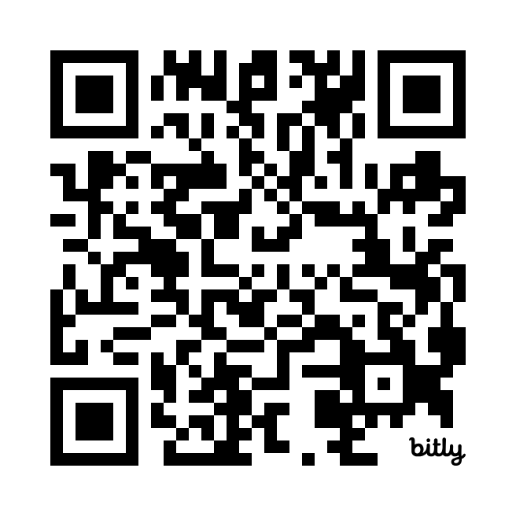
APPLICATION OPEN: John Hancock Award
Special recognition for elementary schools that demonstrate excellence in cursive writing
John Hancock Banner & Proficiency Ribbon: Awarded to schools where 90% of third-grade students can write their name in cursive
John Hancock Banner & Ribbon of Distinction: Awarded to schools where 90% of third-grade students can write both their name and the Preamble to the U.S. Constitution in cursive
Submission Link:
Submissions due by June 1, 2025 or the last day of the school district’s academic year, whichever is sooner.

Slide 7
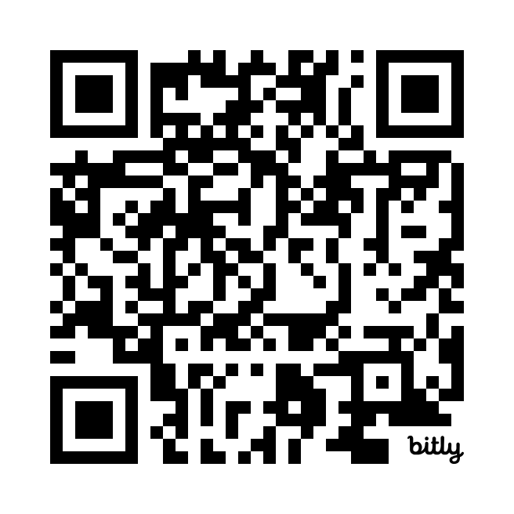
District Deadlines & To-Dos Dashboard
Real-time updates on upcoming deadlines and to-dos for districts and schools, all in one place.
View the dashboard:

Slide 8
CTAE Delivers
Dr. Barbara Wall
Deputy Superintendent for Career, Technical, and Agricultural Education (CTAE)

Slide 9
CTAE = Workforce

Slide 10
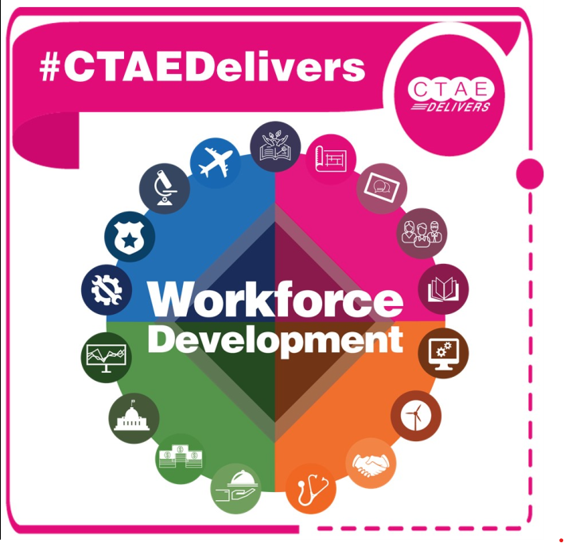
CTAE Responds to Workforce Needs

Slide 11
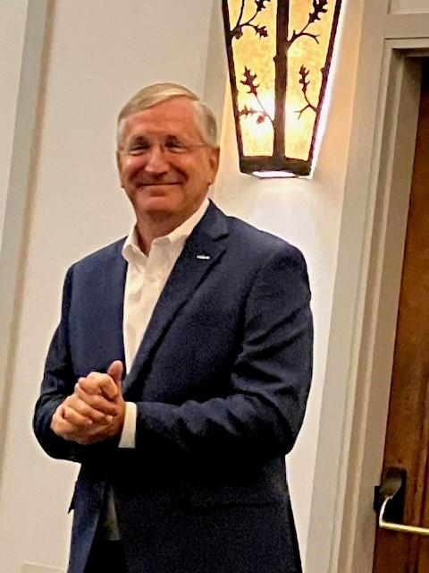
Stuart Countess
President and CEO KIA Georgia
Joseph Lillyblad
Director of Education and Workforce Development

Slide 12
Business & Industry Advisory Committees
Strategy
Alignment
“A Blueprint”
Best Practices

Slide 13
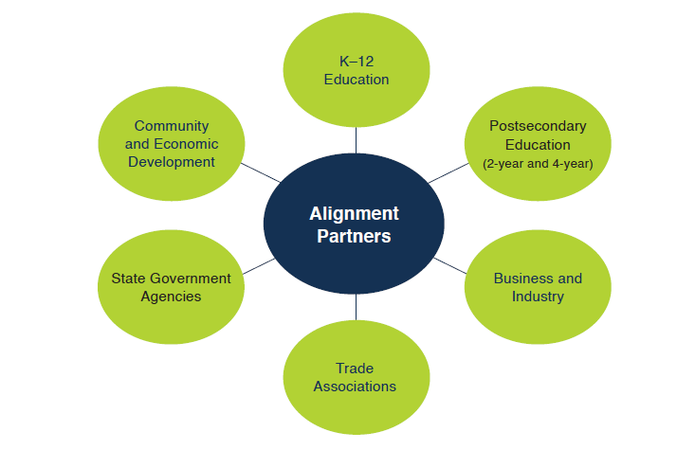
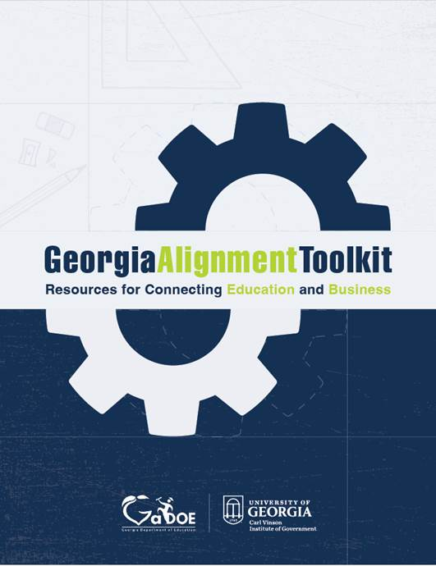
Alignment

Slide 14
Economic Development Partnership Designation

Slide 15
CTAE = Opportunity

Slide 16
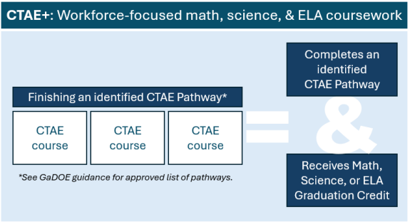
CTAE+
What is CTAE+?
High school students who complete an identified CTAE pathway earn CTAE pathway credit and core credit for graduation.

Slide 17
CTAE+ (cont.)
Recognizes the academic application in CTAE coursework
Multiple pathways identified for core credit:
14 in mathematics
8 in English Language Arts (ELA)
8 in science
Meets the admission requirement for TCSG institutions
New! CTAE+ now satisfies the 2nd core requirement for the Accelerated Career Diploma

Slide 18
Expanding Postsecondary Opportunities for Students
Articulated Credit
Students earn CTAE and college credit by successfully completing identified pathways and being successful on EOPAs.
Accelerated Career Diploma
Students can jumpstart their technical college careers by completing 9 required credits and earning 2 TCCs, tech diploma, or an associates.
High Demand Careers
Students have access to a unified list of high demand careers in the state. Schools receive an additional ½ credit on CCRPI for alignment.

Slide 19
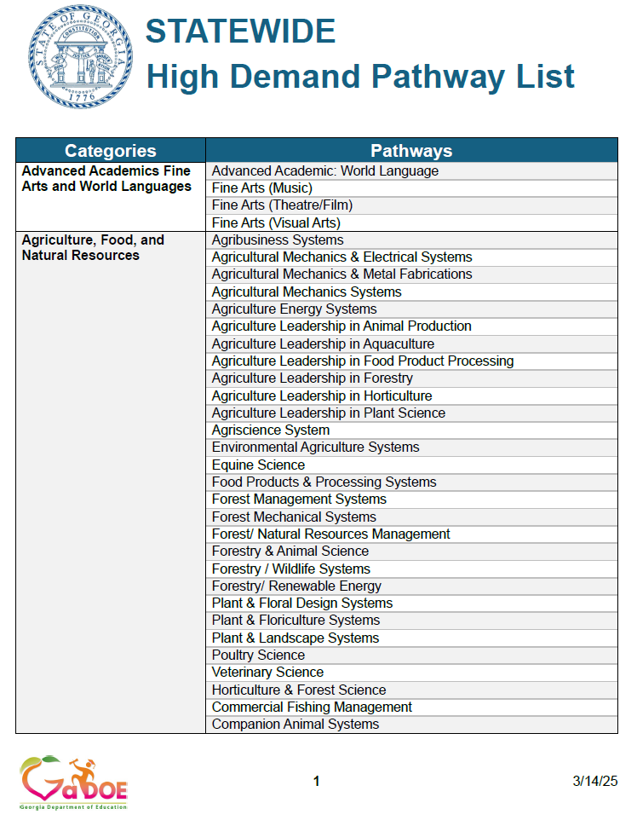
High Demand
Requires the State Workforce Development Board to develop, approve, and annually publish a High Demand Career List – (December 2024)
Identify careers that are most critical to current and future workforce needs
Statewide list (March 14, 2025) AND Region Lists (June 18, 2025)
Schools earn 1.5 points on CCRPI

Slide 20
Expanding Postsecondary Opportunities for Students
Modernized Career Clusters
New guide and framework will be rolled out to CTAE leaders and educators at the upcoming GACTE conference.
Perkins/WIO Combined Plan
Collaborative effort between GaDOE and TCSG. Will be recommended to the SBOE for approval in May.

Slide 21
High Demand (cont.)
Includes High Demand Career list
Replaces existing career clusters with new modernized career clusters. (from 17 to 14)
Cleans up and renames BRIDGE Bill to Top State for Talent Act.
Renames “graduation plan” to “individual college and career plan”.
Provides grant funds of $1,250,000 in FY 26 budget for equipment to align with HDCL.
Adds State Board of Ed to Articulation agreements and encourages Board of Regents to work with TCSG.
Expands need to provide counseling in grades 6-12.
GaFutures required for 9th graders.
Ga Match program codified.
Top State for Talent Act

Slide 22
CTAE = ROI

Slide 23
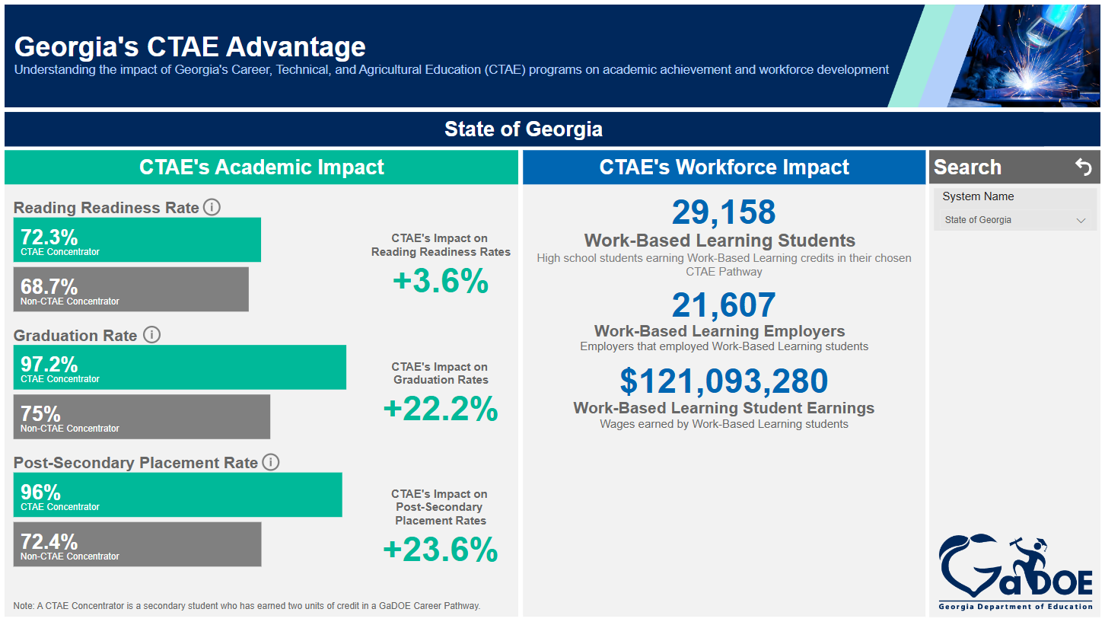
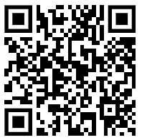
Georgia’s CTAE Advantage
CTAE’s academic and workforce impact
State and district level impact
Great data for superintendents, CTAE educators, community chambers and business leaders, and policymakers
gadoe.org/ctae-advantage

Slide 24
Georgia’s CTAE Advantage
CTAE’s impact on increasing literacy rates and graduation rates
CTAE’s impact on increasing post-secondary rates – going into the workforce, military, technical colleges, and universities
+23.6% impact on post-secondary placement rates

Slide 25
Georgia’s CTAE Advantage
29,000 WBL students supported in the workforce
Working with over 21,000 employers
Earning over $121 million dollars annually for the local and state economy
$121 million in annual earnings by WBL students

Slide 26
GEORGIA
#1 STATE FOR BUSINESS

Slide 27
GEORGIA
#1 STATE FOR CTAE

