Slide 1
THE OF LITERACY
Driving Implementation Forward

Slide 2
Literacy is the long drive . . .
everything else in learning follows its direction.

Slide 3
Where are we with implementation?

Slide 4
Follow the Cart Path
The Implementation Journey
4
FULL IMPLEMENTATION -
ON THE GREEN
Skillfully using and integrating the innovation.
5
INITIAL IMPLEMENTATION -
GETTING OUT OF THE ROUGH
3
SUSTAINABILITY -
THE 19TH HOLE
Trying out the innovation; establishing systems of support with feedback loops.
Securing long-term commitment and continued growth.
1
EXPLORATION -
TEEING UP
2
Setting a vision; creatiing a collaborative team to identify the need and the best innovation.
INSTALLATION - READING THE SHOT
Securing staff buy-in and leadership support; building the plan.

Slide 5
Georgia Council on Literacy
Literacy
Georgia Council on Literacy
Executive Committee
Birth - Five
K-12
Barriers
Professional Development
Community and Family
Leadership

Slide 6
Georgia Early Literacy and Dyslexia Act
Literacy
Georgia Early Literacy and Dyslexia Act (HB 307, 2025)
Georgia Early Literacy Act (HB 538, 2023)
Georgia’s Dyslexia Legislation (SB 48, 2019)

Slide 7
•Combines previous HB 538 (2023) and SB 19 (2019)
•Name change – Georgia Early Literacy and Dyslexia Act
•Added definitions – Characteristics of dyslexia, dyslexia, foundational literacy skills, parent or guardian, significantly at risk of not attaining grade level proficiency, three-cueing system
•Every three years, beginning in 2027, the Deal Center shall review screeners and make recommendations for approved list
•GaDOE must publish on its website and distribute electronically to districts by July 15 each year a copy of the Dyslexia Handbook
•Districts must certify that they have provided the Dyslexia Handbook electronically to all administrators and teachers
•Reporting changes to eliminate requirement to report on assessments that are no longer funded
•Dyslexia reporting clean up
House Bill 307

Slide 8
•Language added to allow for use of multiple data points in identifying students who are significantly at risk for not achieving grade level proficiency
•This bill specifies “school days” for deadlines
•Bill bans the use of three-cueing for teaching word reading
•Creates within GOSA the Literacy Coach Coordinating Committee
•Creates the Coordinator of Georgia Literacy Coaching through GOSA
•Extends the Georgia Council on Literacy to December 31, 2030
House Bill 307

Slide 9
1
High-Quality Instructional Materials
Staying the course
Report due by August 1, 2025.
2
Universal Screening
3 Times per year
New screener list of 5 screeners
Screening covers all required components for dyslexia screening
3
Tiered Reading Support Plans
Included as part of screening reporting
4
Professional Learning for K-3 Teachers
Report due by August 1, 2025
5
Required Reporting
New certification of distribution of dyslexia handbook

Slide 10
Understanding Georgia's
K-12 ELA Standards Course
Teeing Up the new K-12 ELA Standards
A three-module Georgia Learns course based on the information shared during the January and March Leader Tours but modified for teachers.
While the intended audience of the course is new teachers, leaders and teachers at all experience levels can benefit from the information in these modules.

Slide 11
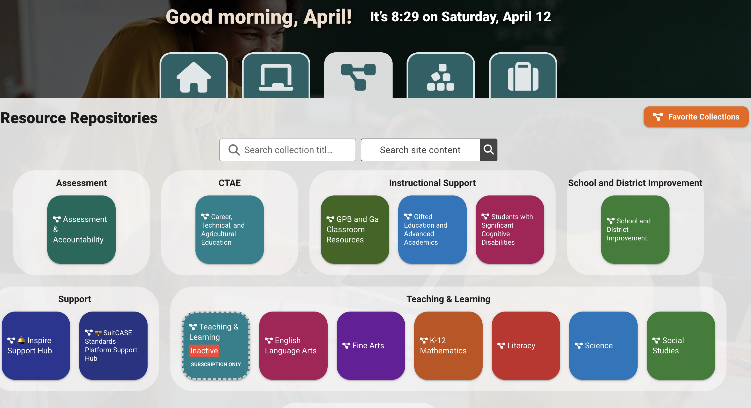
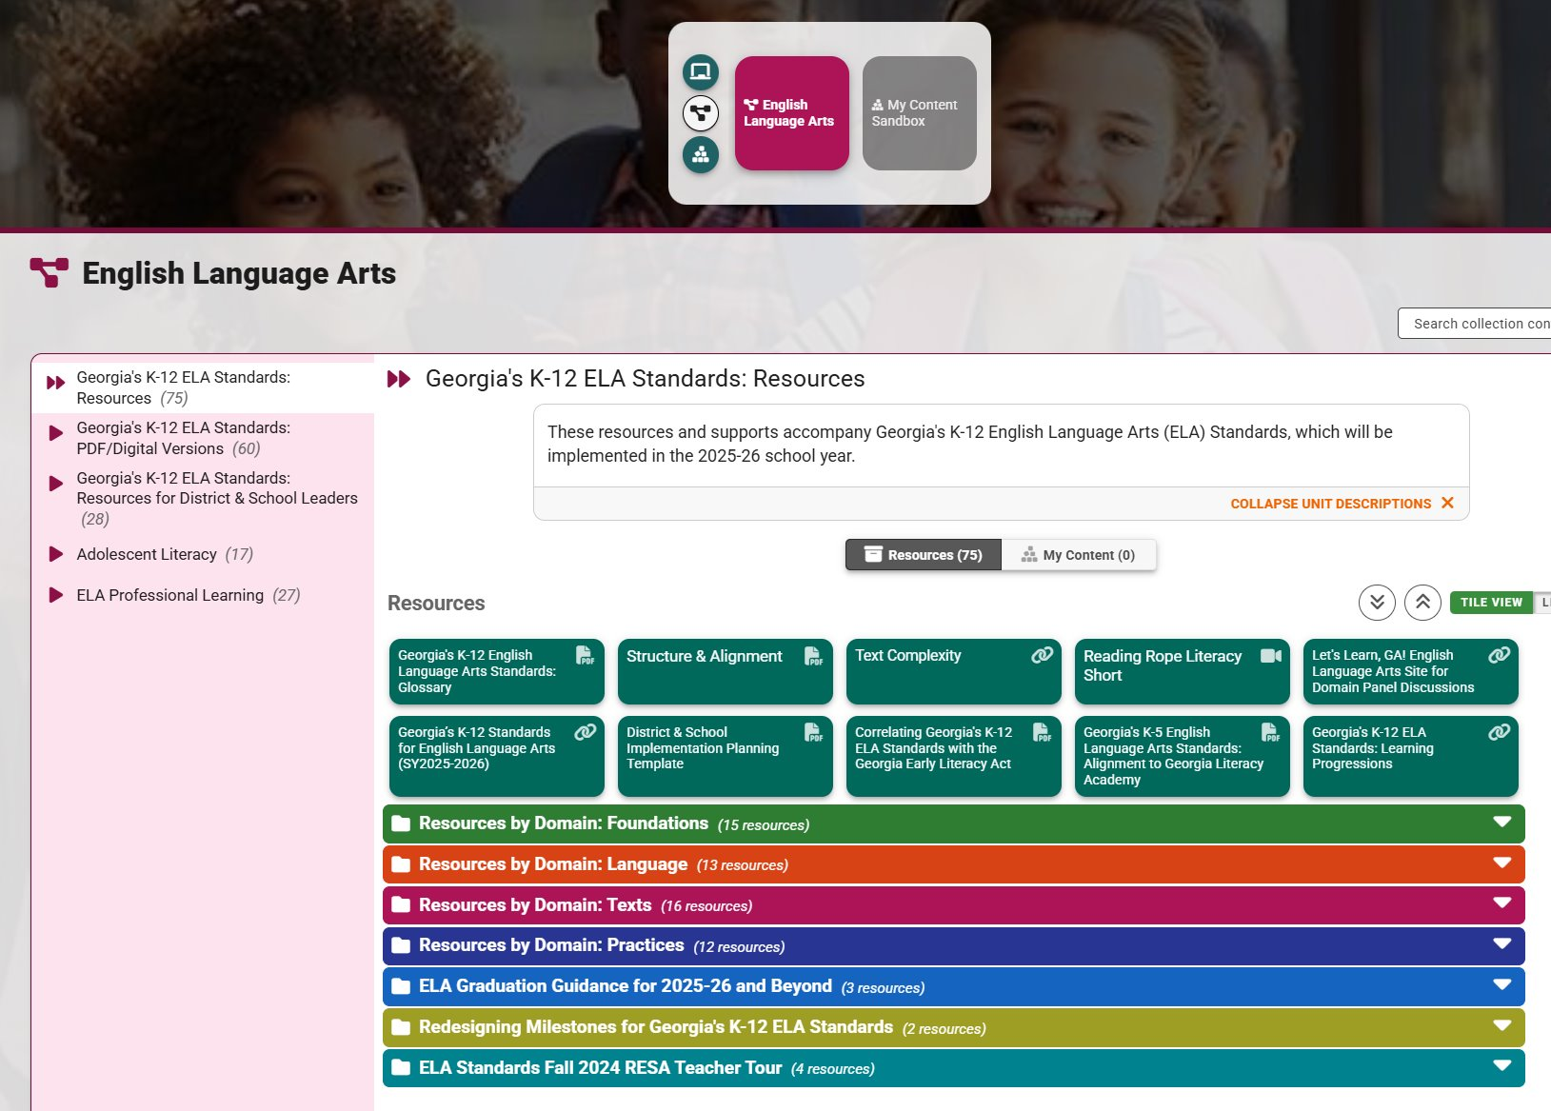
GaDOE SUITCASE
Teeing Up the new K-12 ELA Standards
Remember to LOG IN to access all resources!

Slide 12
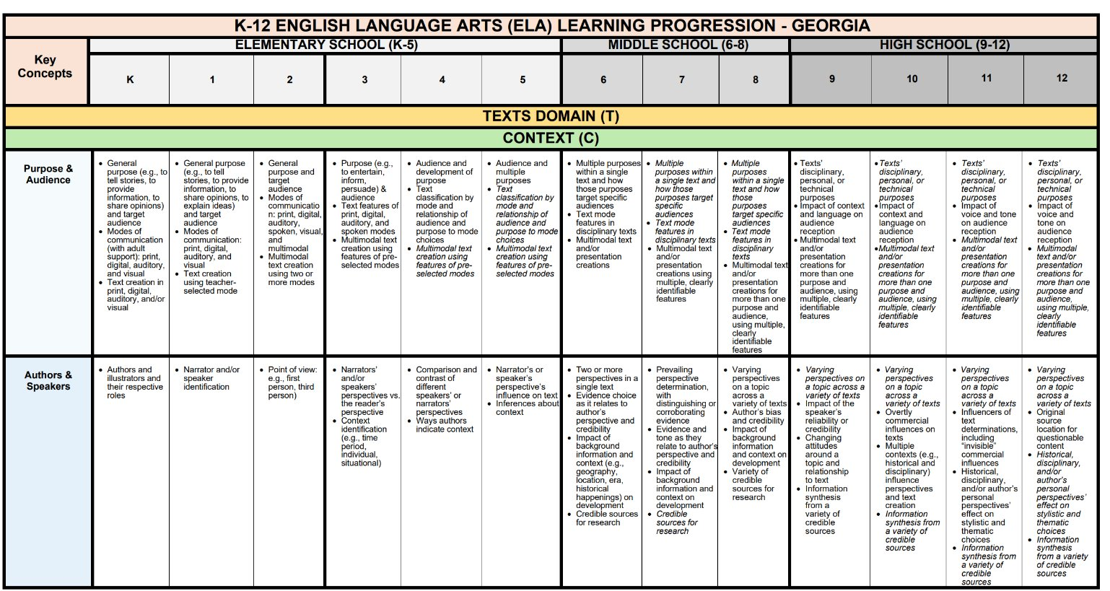
K-12 ELA Learning Progressions
Teeing Up the new K-12 ELA Standards
Quick glance at K-12 ELA skill progressions
Contextualization of skills
Acceleration
Remediation
Vertical Alignment
Parallels Mathematics' Learning Progressions document for familiarity
https://url.gadoe.org/oot7s

Slide 13
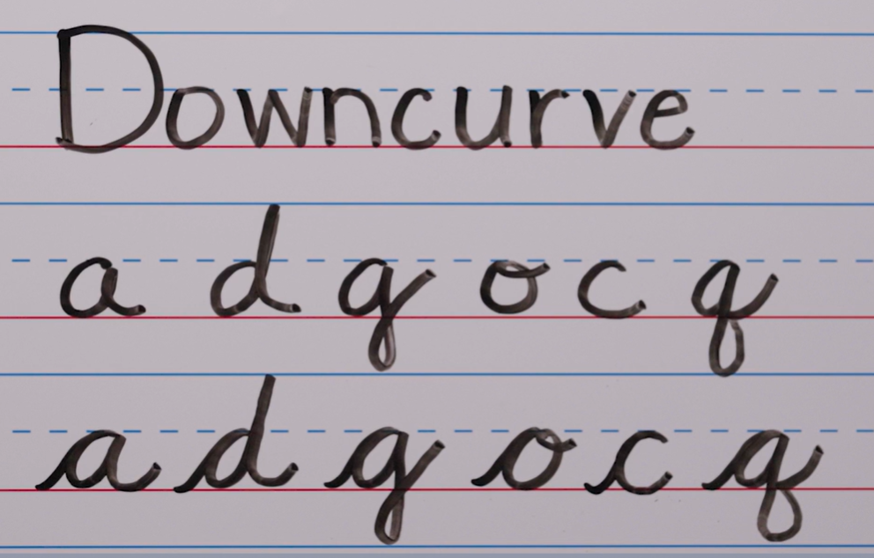
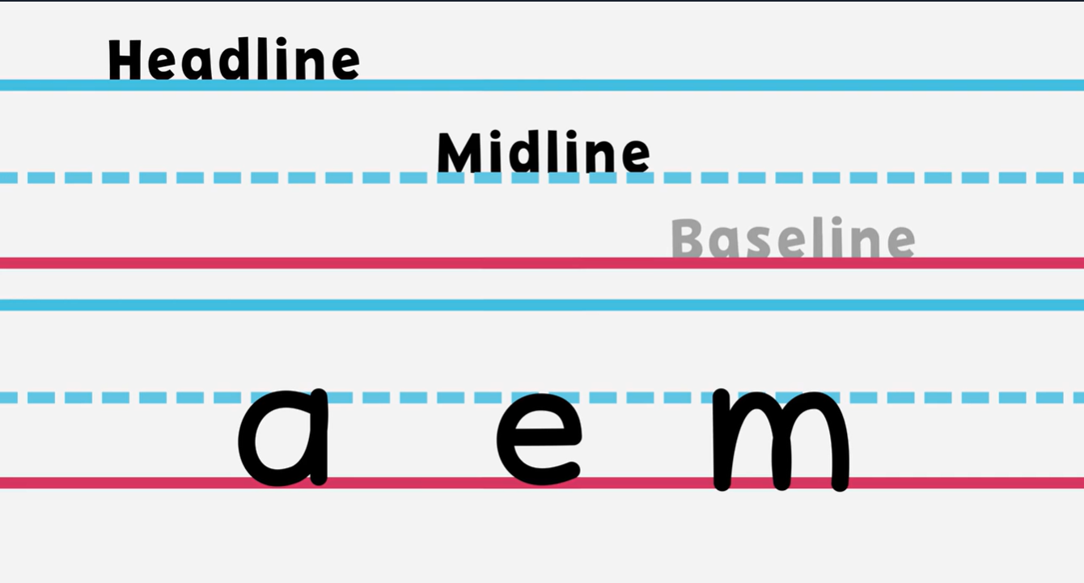
Print and Cursive Handwriting Guidance
Teeing Up the new K-12 ELA Standards
Print Handwriting Guidance for Grades K-2
Cursive Handwriting Guidance for Grades 3-5
Print Letter
Handwriting Videos
Cursive Letter
Handwriting Videos

Slide 14
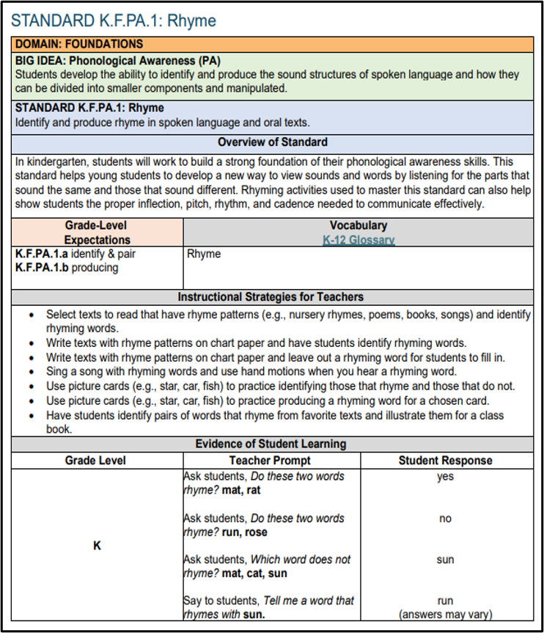
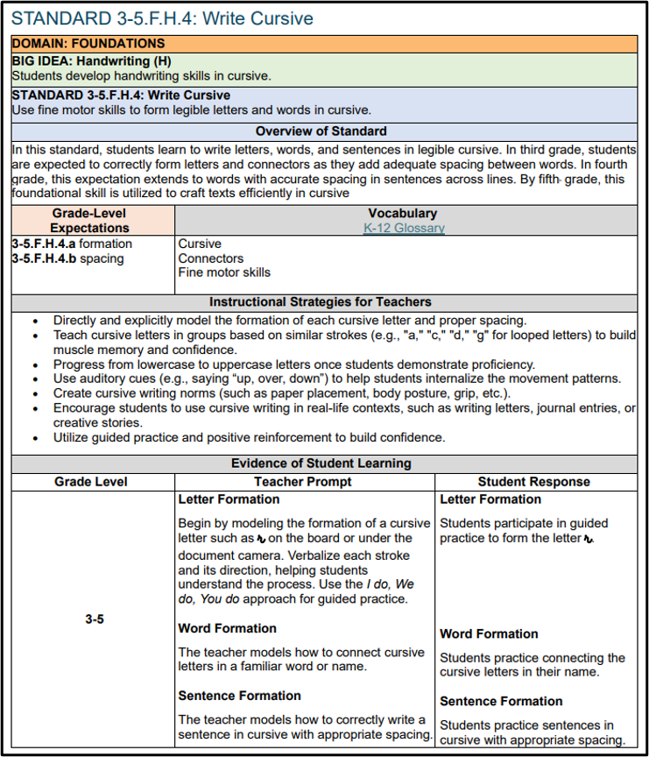
Evidence Documents for the Foundations and Language Domains
Teeing Up the new K-12 ELA Standards
K-2
3-5
https://url.gadoe.org/xmigf
https://url.gadoe.org/cvc2s

Slide 15
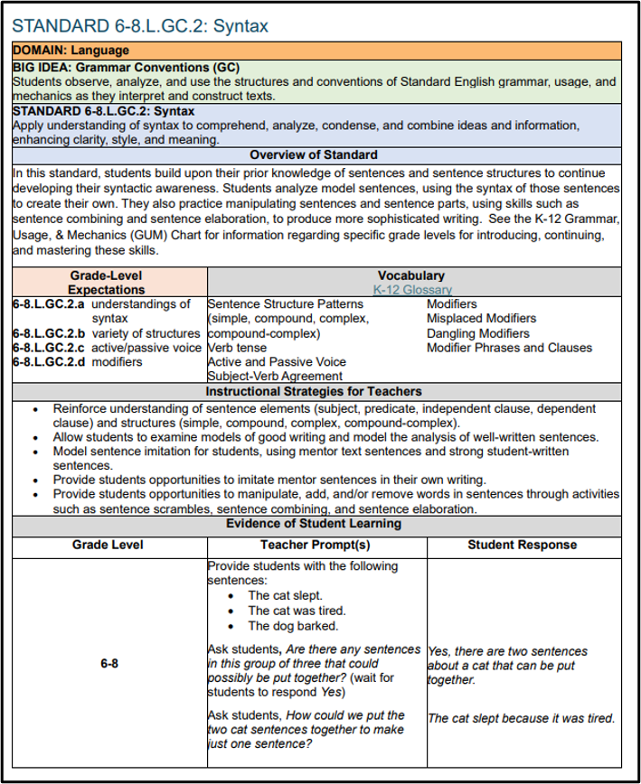
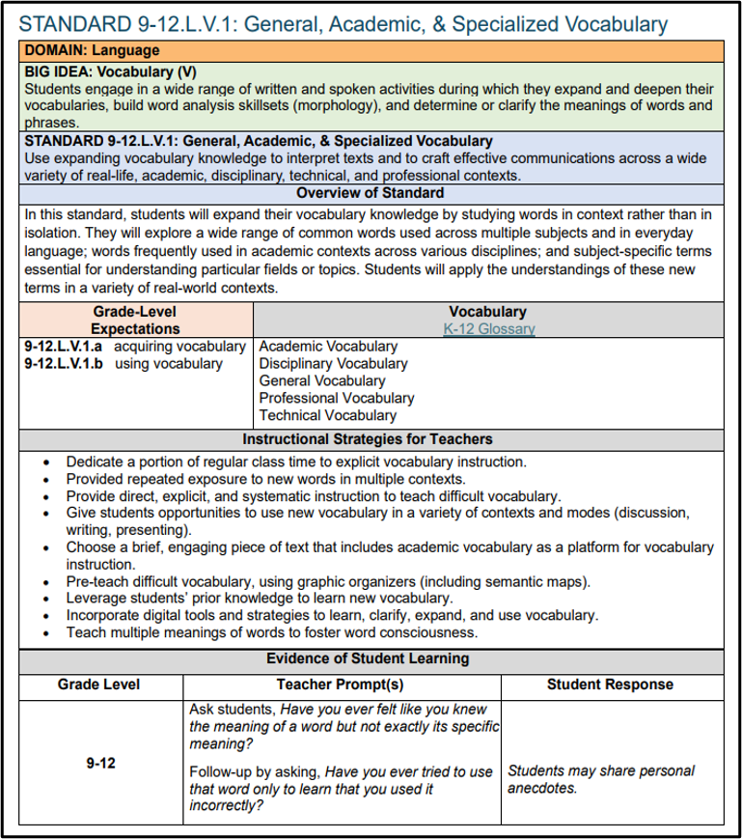
Evidence Documents for the Foundations and Language Domains
Teeing Up the new K-12 ELA Standards
6-8
9-12
https://url.gadoe.org/960n0
https://url.gadoe.org/32xdx

Slide 16
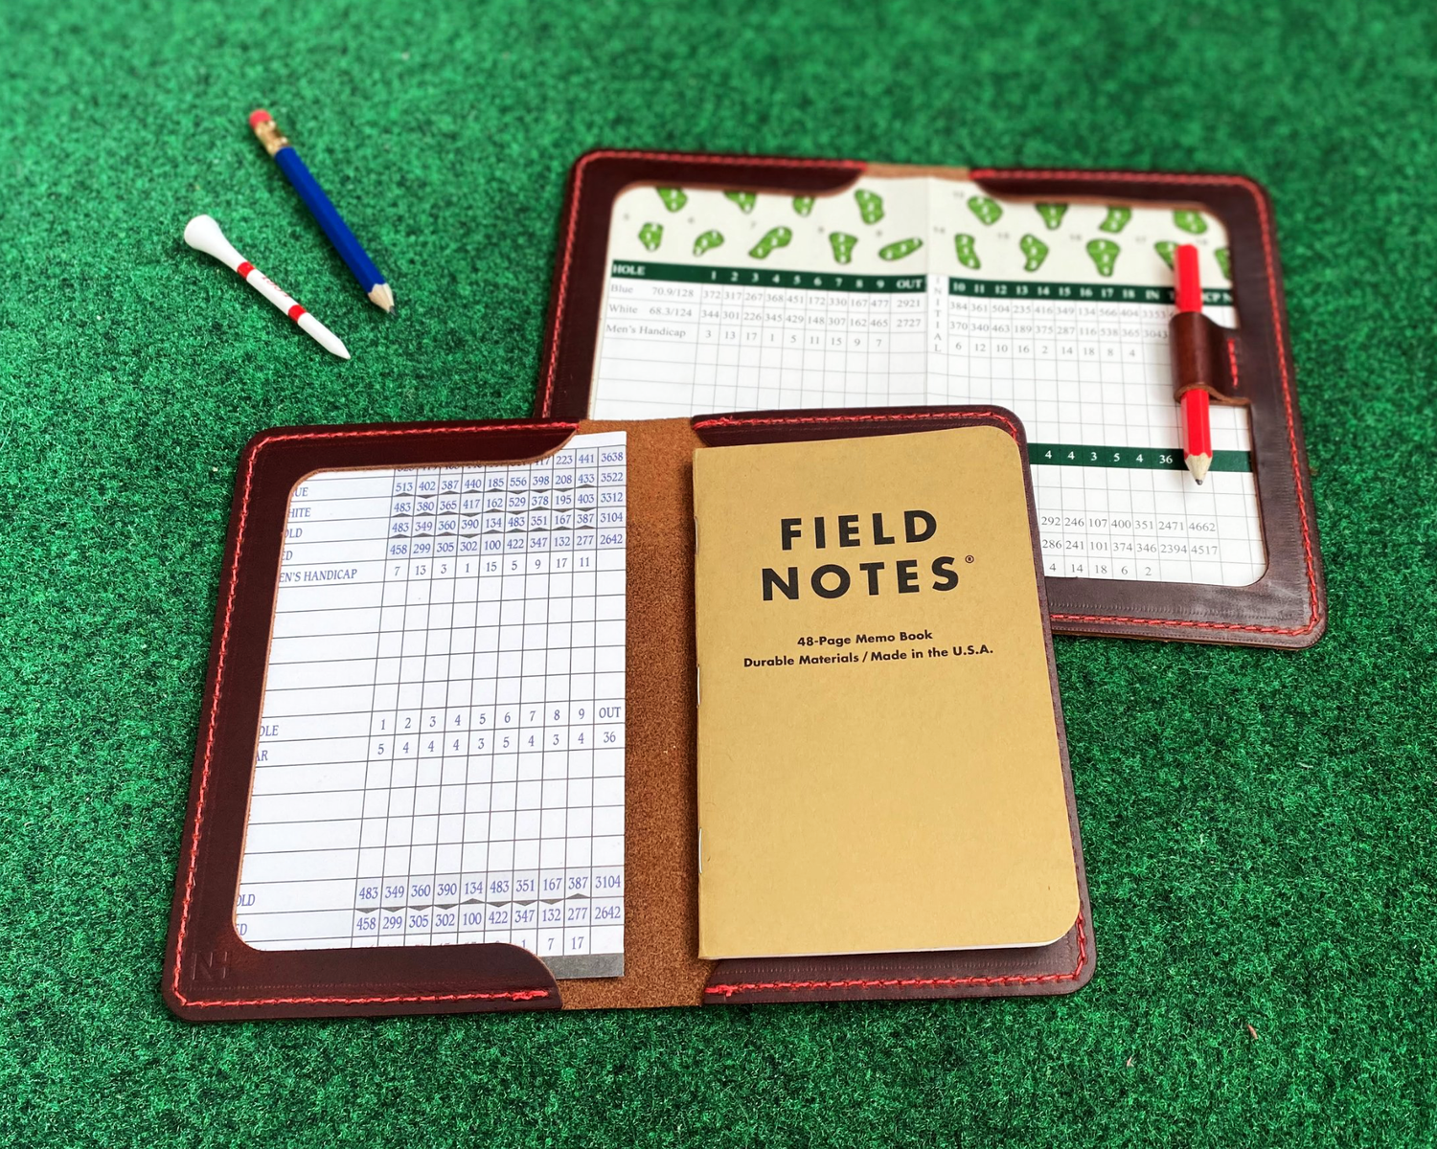
Teeing Up the new K-12 ELA Standards
The ELA Implementation Blueprint: Resources for Implementaton
Learn More about what’s available
NOW
to support
implementation
CLICK HERE

Slide 17
Supporting the Game
CLICK HERE TO ACCESS
Georgia EdTALKS
Professional Learning Bundles

Slide 18
Contact Us!
Meet us on the fairway.
Dr. April Aldridge
Deputy Superintendent of Teaching and Learning
april.aldridge@doe.k12.ga.us
Amy Denty
Director of Literacy
amy.denty@doe.k12.ga.us

