Slide 1

Human Error and
School Safety Planning
Garry W. McGiboney, Ph.D. Chief Operations Officer, Health Security Dynamics Consulting
Consultant for Readiness and Emergency Management for Schools (REMS) Technical Assistance (TA) Center United States Dept. of Education
Notes:
Good afternoon. I’m glad to be here. Thank you, John for the invitation to present today. Today presentation is a brief introduction on how human error is jeopardizing the safety of our school. The REMS logo is based on work I’m doing with REMS that sponsors nation wide webinars and training sessions I provide on human error. The 3 or 6 hour training sessions are also available to you. Also, I’m a member of the American Society of Safety Professionals. That’s because I had to go outside of the field of education to study human error and safety.

Slide 2
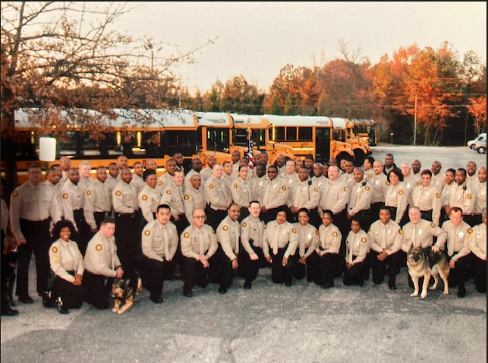
Notes:
I want to give a little perspective, so you’ll know where I’m coming from. I seldom talk about my background or experiences, but I’m going to make an exception today. I’ve written many Safe school plans, continuity of operations plans, emergency operations plans. I’ve been appointed to serve on safety committees by the House, Senate, and Governor’s office. I’ve worked with GEMA on safe school planning. I’ve worked with FEMA on school safety manuals. I’ve worked with school districts, law enforcement at the local, state, and national levels. I worked in a school district with 145 schools and centers and we were one of the first if not the first school district in Ga to have all 145 School Safety Plans reviewed and approved by GEMA. We had a big celebration at our local board meeting - the the director of GEMA attended. We were one of the first school districts to have survellienance cameras in all schools and center with a central command center in my office whereby I could go to any of the cameras. We were the first school district in the state to create student discipline tribunals following Goss Lopez Supreme Court case gave students due process rights. I was the first hearing officer and heard over 10,000 discipline cases, which gave us insight into safety issues. We had a contract with the local police department for SROs, but as our concerns elevated I suggested to the our board to create our own school police department and I was tasked with building from the ground up a school police department – so I traveled around the country looking at school police departments, I worked with FEMA and GEMA, and the Sheriffs association, FBI, Secret Service and many more experts like the National School Safety Center. And with COPS federal grants as seed funding, we built a 70-member school police force that included two K-9 units and an investigation unit. We were in the national news because we were one of the first school districts to have intruder alert drills and active shooter drills and shelter in place drills. I’ve conducted over 600 school safety audits, across Ga and across the nation. despite all of that, tragedies happened: one of our students shot and killed a teacher. The student made it through a metal detector that was manned by experience police offices. I was in the school when it happened. We had a student stabbed to death by another student with a pocket knife with a 2 inch blade – a 2-inch blade. We had a student bring a paddle board to school with nails in it and he swept it across the face of another student, we had a student suffering from severe depression take a boxcutter to the face of another girl who was bullying her. We had a fire break out that damaged a school; it happened because a teacher improperly stored chemicals in his science class. I’ve testified in juvenile court, state court, superior court, and federal court. I’ve testified in three murder trials. (click

Slide 3

Our schools are not as safe as they should be.
Notes:
I say all of that to say this: I’ve always felt like we were missing something. Why with all of the safety personnel, technology, plans, practices, procedures and programs were tragedies and near tragedies still occurring? It plagued me for years. A few years ago, I was at the Delta Museum at the Atlanta Jackson Hartfield Airport. As I was leaving the event, I saw a sign that said “Aviation Safety Conference”……So, I went to the registration desk…five breakout sessions on Human error. And I realized that I’ve never heard anyone talk about human error in the school safety context. Sure, I risk management has been around but not human error. I asked REMS staff to find training on human error in K-12 education. Couldn’t find any. So, I spend a lot of time in other professions learning about human error. I’ve attended training sessions and conferences about human error. And that brings us to this today. We must include the possibility of human error in our school safety planning and staff training. I’m not talking about risk mgt that ensures we have policies to reduce exposure to risk. I’m talking more about the human element. Until we start talking more about human error, ladies and gentlemen, our schools will not be as safe as they should be.

Slide 4
“We must accept human error as inevitable and design around that fact.”
-Donald Berwick
Notes:
Let’s start with this: “We must accept human error as inevitable and design around that fact.”

Slide 5

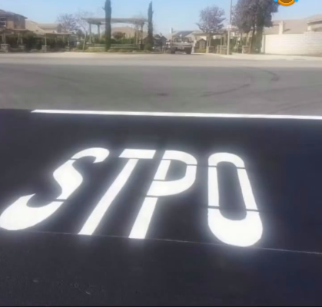
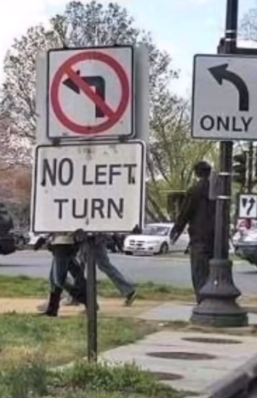
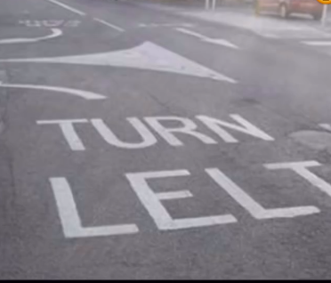

Human Error is not rare…
Notes:
Sometimes we don’t even notice human error. Human error is not rare. Thanks to Keith Porter, I had the prevalenge of providing a full day of training last week for new superintendents on human error and one of them noted that the sign on the far right has obviously been there a long time – it’s time worn – what does that mean – no one is paying any attention anymore. The human error is the norm.

Slide 6
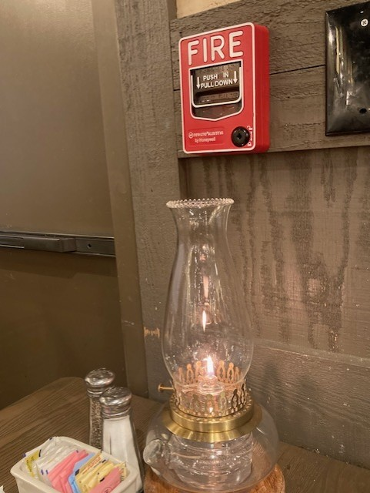
Human Error is not rare…
Notes:
How common is human error? Recently, I was in a Cracker Barrell restaurant and saw this. Do you see the instructions on the fire emergency box: “Push and pull down” right into a lit lamp. That’s human error. I pointed it out to the manager and she said no one had even noticed that and she said she would take care of it. Two weeks later, what did I see?

Slide 7


What is Human Error?
The most cited definitions of human error: “The failure of planned actions to achieve their desired purpose, which does not include intentional or malicious acts.”
Human error includes slip-ups, lapses, mistakes, and violations that are not intended to harm anyone.
Icarus Myth: Don’t become so infatuated with your experience and training that you overlook risks.
Notes:
So, what is Human Error? One of the most cited definitions of human error comes from Dr. James Reacher at Stanford University; he writes that human is “The failure of planned actions to achieve their desired purpose, which does not include intentional or malicious acts.” Human error includes slip-ups, lapses, mistakes, and violations. It is human nature to drift away from procedural compliance and to develop unsafe habits for which we fail to see the risk. Does anyone see the significance of the picture on the cover of Dr. Reason’s book? (click) The myth of Icarus: he made wings and attached them together with wax and was so infatuated with his ability to fly that he flew toward the sun and the wax melted, so the morale of the story, according to Dr. Reacher, Don’t become so infatuated with our experience and training that we overlook risks.

Slide 8

Human error is the primary cause of 90% of industrial accidents.
Human error causes 80% of aviation accidents.
Human error causes 75% of marine accidents.
In the medical field, human error causes over 200,000 deaths per year, which makes human error one of the top three causes of deaths in the United States.
Human error is the cause of 95% of cybersecurity accidents.
Human error causes 75-80 % of construction site accidents.
Human error causes 80% of processing plant accidents.
Human error is the cause of 94% of vehicle accidents.
Human error is the cause of 70% of medical device recalls.
Over 50% of all environmental disasters are caused by human error.
Human error is the top threat to information security for all businesses and organizations, including schools, with over 80% being caused by human error.
Notes:
When I first became interested in human error, I was curious about the prevalence – let’s look at some staggering statistics. Human error is the primary cause of 90% of industrial accident. Human error causes 80% of all aviation accidents. Human error causes 75% of marine accidents. In the medical field, human error causes over 200,000 deaths per year, which makes human error one of the top three causes of deaths in the United States. Human error is the cited cause of 95% of cybersecurity accidents. Human error causes 75-80 % of construction site accidents. Human error causes 80% of processing plant accidents. Human error is the cause of 94% of vehicle accidents. Human error is the cause of 70% of medical device recalls. Over 50% of all environmental disasters are caused by human error. Human error is the top threat to information security for all businesses and organizations, including schools, with over 80% being caused by human error. There is no doubt that human error is part of our lives and thus we cannot ignore it. HOWEVER, human error is seldom if ever included school safety training.

Slide 9
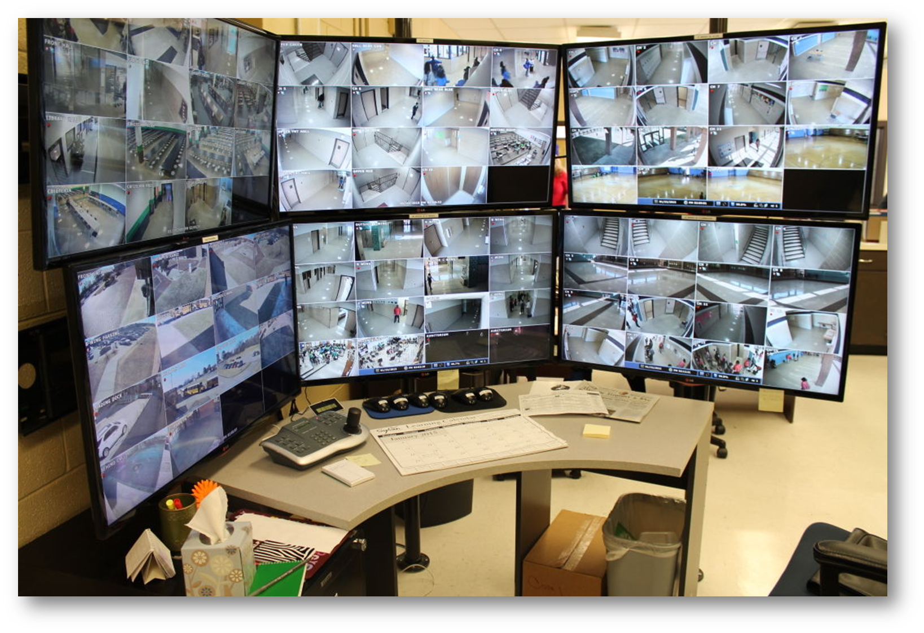
Notes:
Human error applies to schools, too. The school principal was proud of the 96 surveillance cameras that were added to his high school. When I asked him who monitors the cameras, he said an SRO is supposed to, but he probably stepped away for a few minutes (human error). I asked him if that was common – he said yes, he’s called away all the time.(click)

Slide 10
Notes:
In the meantime, I started looking at the cameras and asking questions, which made the principal look, too. In those few minutes (probably 3 minutes) we identified several situations taking place in the school at that time that needed attention – students in the hallways, cameras not functional, and even what the principal said looked like someone in the hallway that is not a student – see the person in the red shirt in center near the bottom. And the top arrow is pointing to what looks like a student looking into a classroom.

Slide 11
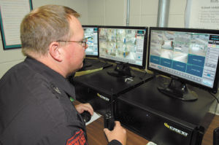
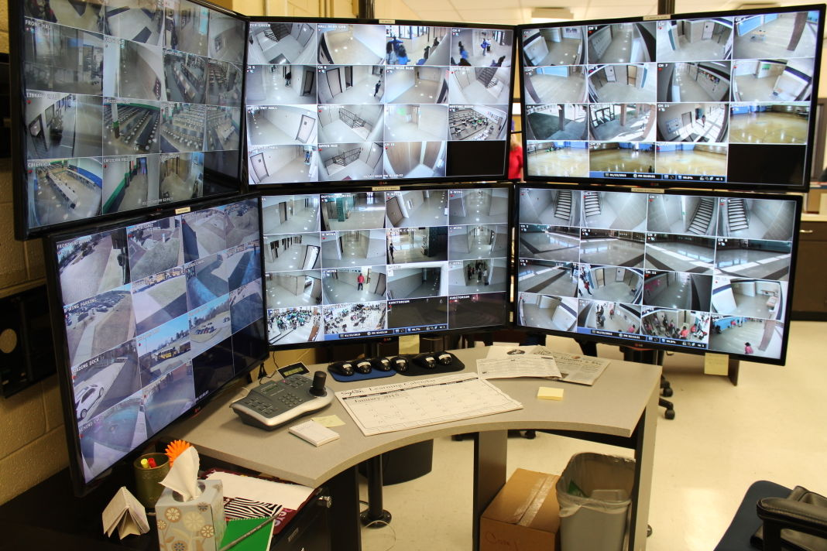
96 cameras
40 cameras
Notes:
So, which is the safest, 40 cameras being monitored consistently, or 96 cameras not being monitored consistently?

Slide 12
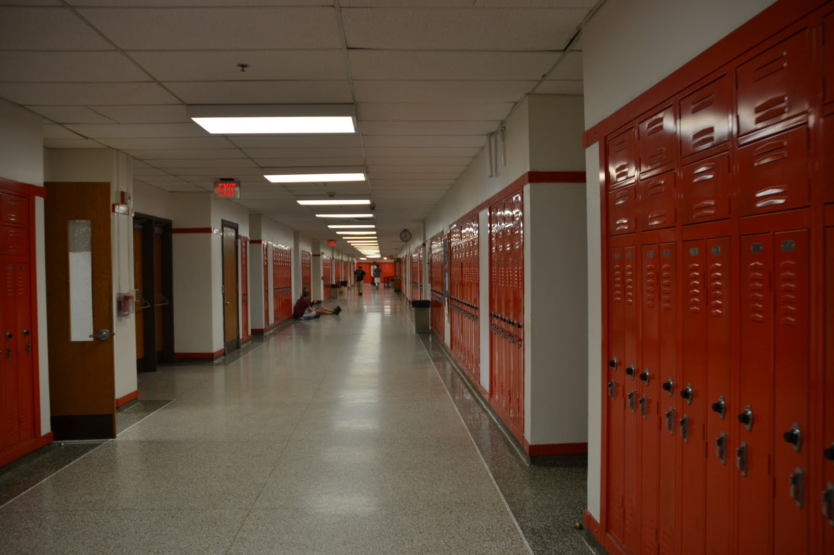
B=f(P,E)
Notes:
Walking the halls in a different high school with the principal. A classroom door is open, students are in the hall, a trash can is in the hall. Human error. The principal said, “Ill take care of these problems because they know all doors must be closed and locked, no students should be in the hallway, and that trash can is going be a hazard in an emergency evacuation.” He said these are violations. I asked him, “What are you going to do?” He said, “I’ll talk to the teacher about the classroom door and I’ll remind all teachers that students can’t be in the hallway during classes, and I’ll move the trash cans myself.” And I said, “And then what are you going to do?” He replied, “What do you mean?” I said, “Do you know why these three things happened?” What caused these three human errors? And he did find out; for example, the classroom door was open because the classroom was so hot it was almost unbearable. Custodian put trash cans in the hallway because his staff was reduced and they had trouble keeping the halls clean, the students were in the hallway because they returned early from a field trip and didn’t want to disrupt classes by knocking on the door. All of these human errors were predictable, which means they were what? Yes, preventable. We should remember what organizational psychology has taught about workplace safety for years: safety must consider that behavior is a function of the person and the environment.

Slide 13
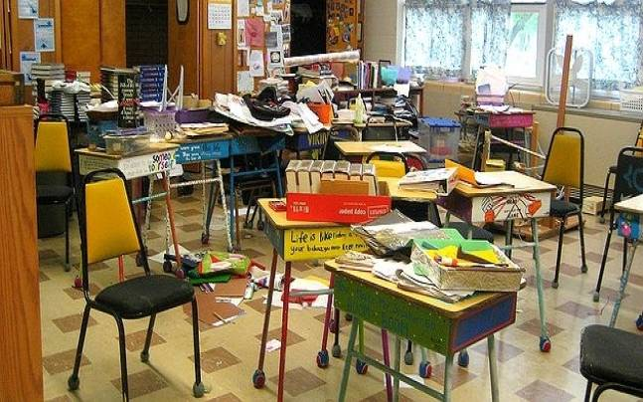
Notes:
A vacant and unlocked classroom at the end of a hall that’s used to store stuff and has for years been used to store stuff. I was told that it’s been like that for years because no one uses it due to a musty smell. (click) I found a knife in one of the drawers – the room is not locked, and neither was the drawer. The teacher across the hall is supposed to keep the door locked but staff and students were always knocking on her door to get the key, so she did what…..? Yep, left the door unlocked. Typical response: “She knows better.” Was that predictable Human error? Yep.

Slide 14

Notes:
A vacant and unlocked classroom at the end of a hall that’s used to store stuff and has for years been used to store stuff. I was told that it’s been like that for years because no one uses it due to a musty smell. (click) I found a knife in one of the drawers – the room is not locked, and neither was the drawer. The teacher across the hall is supposed to keep the door locked but staff and students were always knocking on her door to get the key, so she did what…..? Yep, left the door unlocked. Typical response: “She knows better.” Was that predictable Human error? Yep.

Slide 15
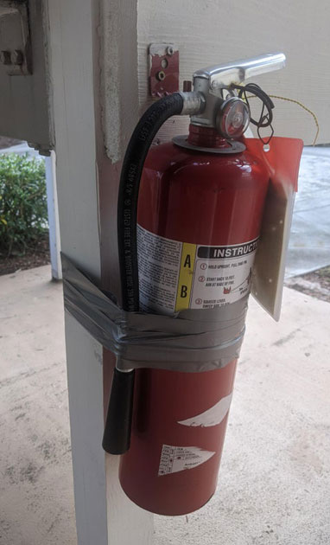
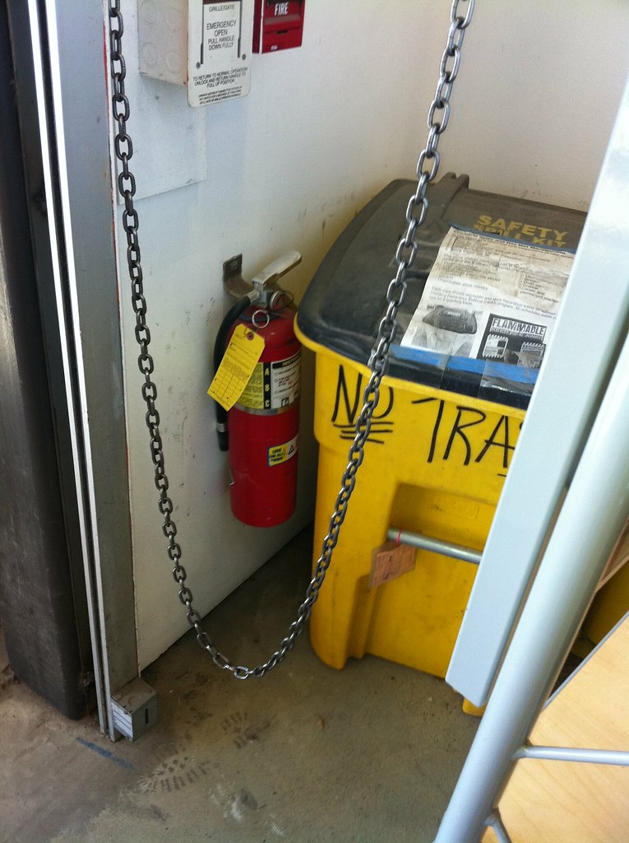
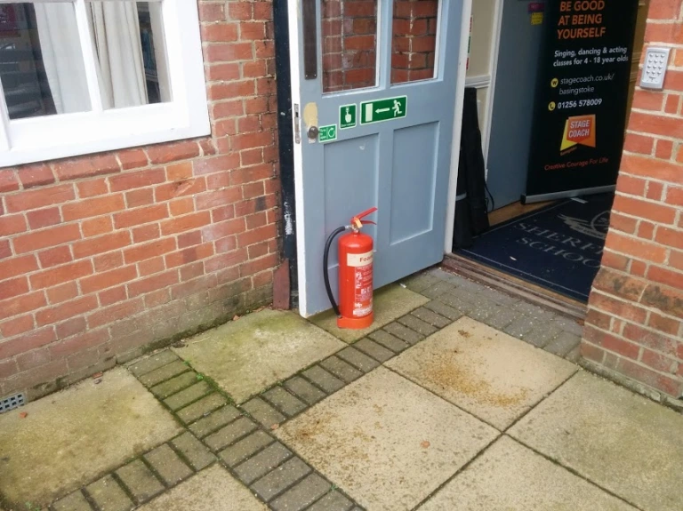
Notes:
Three photos of not only fire extinguishers; these are photos of human error. What do you think caused these situations? Why did staff members do these things? And what we learn from epidemiology, ladies and gentlemen, is that this behavior is not random. There is almost always a rationale, a cause, a determinant AND most of the time there is a pattern. It’s important to understand these are not random – how do you feel when you think something is random – right, you don’t feel like you have any control, so you don’t look for patterns that can predict human error.

Slide 16
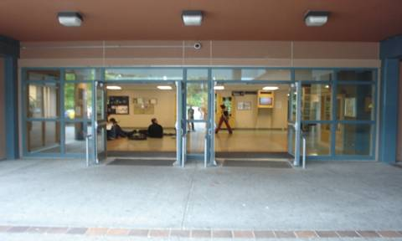
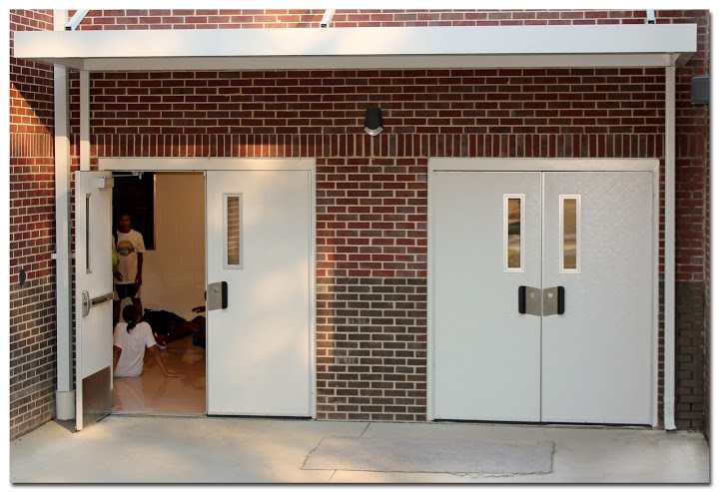
6:30 a.m.
6:30 p.m.
Notes:
What’s wrong with these pictures? The top left is school early in the morning. The bottom right is school in the late afternoon. Human error – rationalization – “nothing much happens before or after school.” When I do safety audits, I tell schools what I’m looking for but there is one thing I don’t tell them, which is I will circle back around after school and I often see doors unlocked or even open.

Slide 17

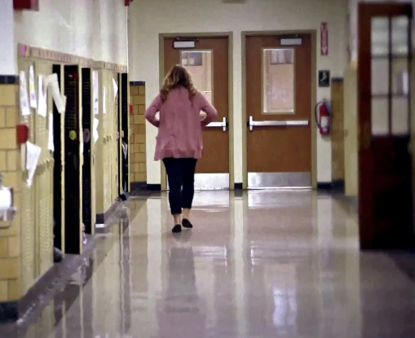
A fifth-grade teacher was on the playground with her students when she lost track of time. Realizing her class would be late for lunch, she rushed everyone back into the school. Once inside, a student exclaimed that she had left her mother’s favorite scarf on the playground and tried to run back outside to retrieve it. The teacher stopped her and told the class to wait in the hallway while she went to get the scarf. During the teacher’s absence, one student wandered away from the group and left the building through a different door. In her haste to return, the teacher failed to ensure that the exterior door was fully closed. She rejoined the remaining students in the hallway near the cafeteria, returned the scarf, and then led them to lunch. However, she did not confirm that all students were present.
Notes:
Consider this case study: A fifth-grade teacher was on the playground with her students when she lost track of time. Realizing her class would be late for lunch, she rushed everyone back into the school. Once inside, a student exclaimed that she had left her mother’s favorite scarf on the playground and tried to run back outside to retrieve it. The teacher stopped her and told the class to wait in the hallway while she went to get the scarf. During the teacher’s absence, one student wandered away from the group and left the building through a different door. In her haste to return, the teacher failed to ensure that the exterior door was fully closed. She rejoined the remaining students in the hallway near the cafeteria, returned the scarf, and then led them to lunch. However, she did not confirm that all students were present.

Slide 18
Human error #1 – the teacher lost track of time and was late for the lunch period;
Human error #2 – the teacher left the students unattended when she went back on the playground;
Human error #3 – the teacher did not secure the exterior door when she went back to the playground nor when she returned from the playground;
Human error #4 – she did not account for all students when she returned from the playground and before leading her class to the cafeteria.
In just five minutes, the teacher made at least four human errors that resulted in what outcomes?
A missing student
A school left with an unsecured exterior door
Notes:
Human error #1 – the teacher lost track of time and was late for the lunch period;
Human error #2 – the teacher left the students unattended when she went back on the playground;
Human error #3 – the teacher did not secure the exterior door when she went back to the playground nor when she returned from the playground;
Human error #4 – she did not account for all students when she returned from the playground and before leading her class to the cafeteria. In just five minutes, the teacher made at least four human errors that resulted in what outcomes?
A missing student
A school left with an unsecured exterior door (If we begin to insert discussions about human error in our training we can cut back on these types of incidents.)

Slide 19
The behavior of the teacher is not random and has a determinant (cause) which means there is a purpose for the behavior that is not intended to harm anyone. Is it predictable?
If it is
PREDICTABLE
it is
PREVENTABLE
Notes:
The behavior of the teacher is NOT intended to be harmful in any way – she’s working hard to take care of her students. But also, her behavior is not random and has a determinant (cause) which means a pattern is possible to detect in the school and perhaps across a school district. BUT ONLY IF WE PAY ATTENTION TO IT; NOTICE IT; CONSIDER IT; and TALK ABOUT Human Error. And what have we learned…if it’s predictable…it’s preventable.

Slide 20

What do these school-related incidents have in common?*
An exterior door was propped open by a rock that allowed an intruder to come into the school. Once inside the school he found a classroom door unlocked. The intruder entered the classroom and held students and the teacher hostage.
An exterior door was not securely closed and was accessed by a gunman who shot at students and staff members.
A classroom door was left open during an intruder alert. The intruder entered the classroom and terrorized students and the teacher.
*From state, national, and international police reports, news media, and social media postings
Notes:
What do the following school incidents have in common? An exterior door was propped open by a rock that allowed an intruder to come into the school. Once inside the school he found a classroom door unlocked. The intruder entered the classroom and held students and the teacher hostage. An exterior door was not securely closed and was accessed by a gunman who shot at students and staff members. A metal detector was left unmanned. A student entered the school with a gun and shot a teacher. A classroom door was left open during an intruder alert. The intruder entered the classroom and terrorized students and the teacher.

Slide 21
What do these school-related incidents have in common?
An 11-year-old student is chronically bullied. The student’s parents and other students reported the bullying to school leaders who took no action. The student committed suicide in the school restroom.
During a school field trip, the school buses made an unscheduled visit to a park. Due to cold weather, the teachers and chaperones remained on the bus while students played outside in the park. A student disappeared and was not found.
A small fire started in a science lab. The fire could not be extinguished because the teacher moved the fire extinguisher. The classroom and one section of the school were severely damaged and two students were injured.
Notes:
An 11-year-old student is chronically bullied. The student’s parents and other students reported the bullying to school leaders who took no action. The student committed suicide in the school restroom. During a school field trip, the school buses made an unscheduled visit to a park. Due to cold weather, the teachers and chaperones remained on the bus while students played outside in the park. A student disappeared and was not found. A small fire started in a science lab. The fire could not be extinguished because the teacher moved the fire extinguisher. The classroom and one section of the school were severely damaged and two students were injured.

Slide 22
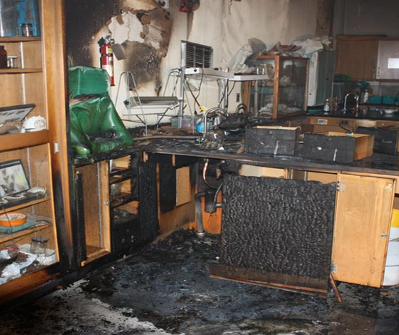
Notes:
Anything seem odd in this photo of the science classroom fire?

Slide 23
Notes:
Yes. The fire extinguisher is in a location where it would be difficult if not impossible to reach during an emergency. But why? Why was it placed there? – It’s because the classroom was so overcrowded the teacher relocated the fire extinguisher because it was next to students. That’s predictable human error. We may focus on the teacher moving the fire extinguisher when we should be focusing on the conditions that led to him moving it. So many of these tragic events can be prevented by focusing on the potential for human error (click).

Slide 24
HUMAN ERROR
Notes:
Yes. HUMAN ERROR

Slide 25
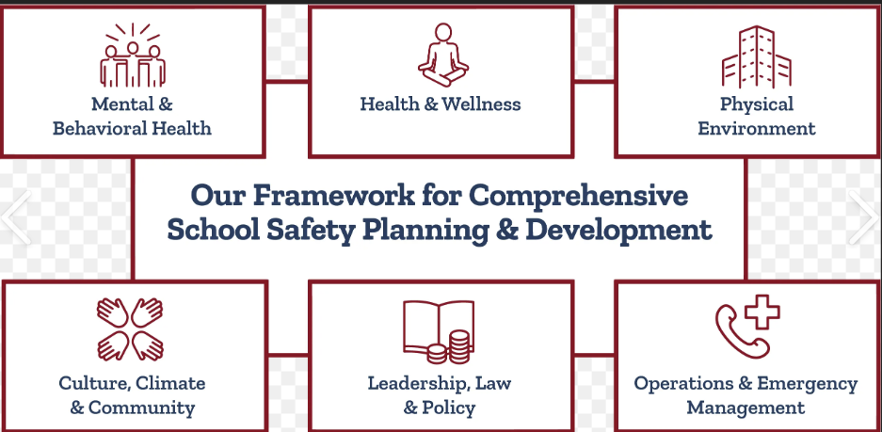
Human Error Awareness Training
Practices
Policies
Technology
Procedures
Notes:
And our plan has all the essential elements in it from mental and behavioral health all the way to operations and emergency management with community and policy in between.

Slide 26
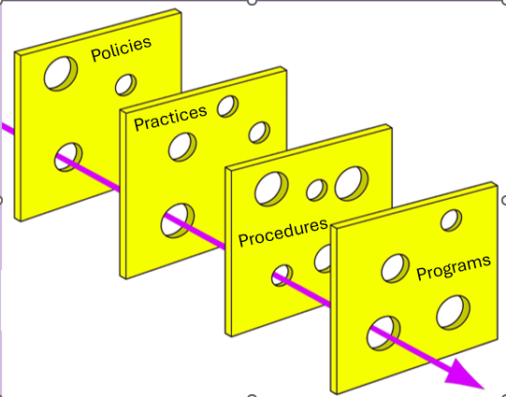
Human Error
Notes:
WE take the approach to safety as do other professions that is called the “Swiss Cheese” concept. We build safety defenses based on layering different elements such as policies (that always have holes); practices (that always have holes); procedures (that always have holes), and programs (SROs, technology, etc.), and so by layering them we hope to create a solid block of prevention. The more layers we can add the safer we become. The problem is that the Swiss Cheese concept does not consider how human error can compromise each layer. That is why other professions focus on human error.

Slide 27
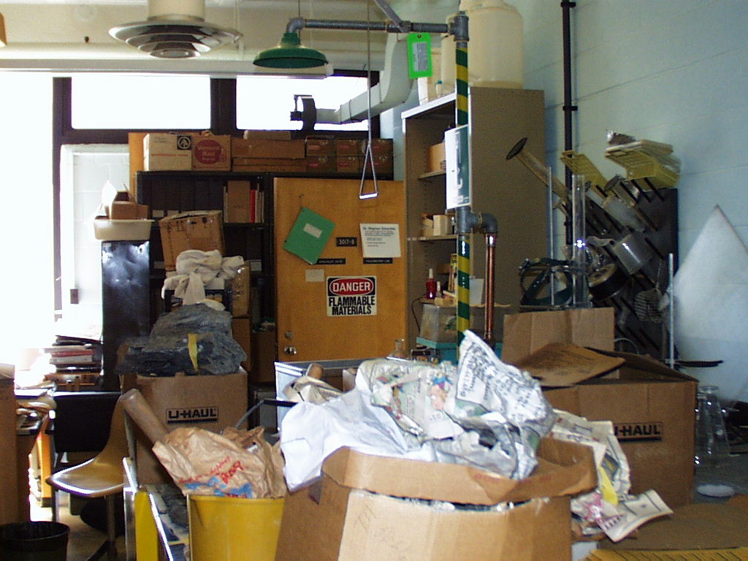
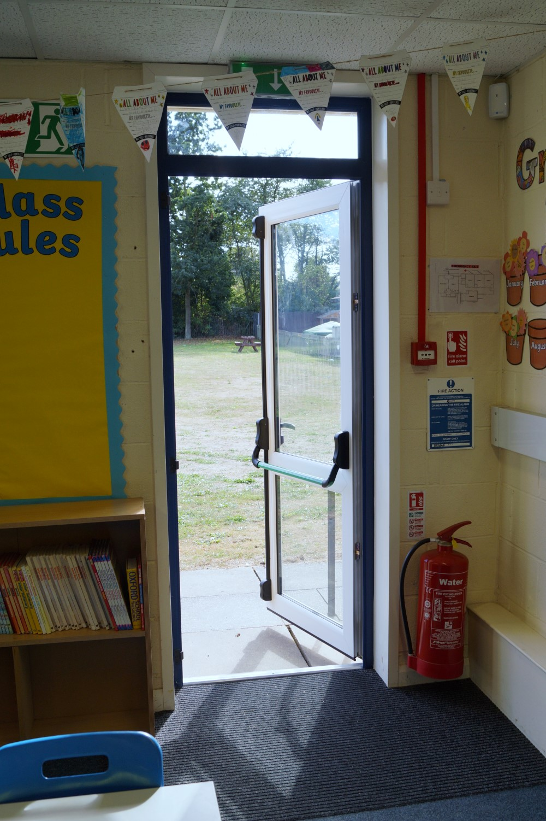

Notes:
But typically, instead of looking at the human error component, we hunker down on planning, processes, procedures, and practices, because that is our risk management approach – that is important but it’s not enough. And we play the blame game – a staff member catches all of the blame.

Slide 28


Human error is endemic, which like the flu means that it is without a doubt going to occur, but the question is -
can we manage it?
Human error can be managed:
If we accept that it exist
If we realize that it can jeopardize even the best technology, policies, and practices, and
If we train staff to be aware of human error
Notes:
It’s important how we frame human error. One way is to consider human error as endemic, which means, like the flu, it is without doubt going to occur, but the question is can we manage it? We cannot eliminate the flu, and we cannot eradicate human error, but can we manage human error? And the answer is yes; we can manage it IF, IF, IF we accept that it exist, if we realize what it can do to our policies, practices, procedures, and programs, and IF we train staff members to be aware of it.

Slide 29
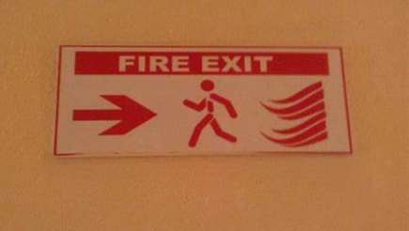
It is human nature to drift away from procedural compliance and to develop unsafe habits for which we fail to see risks.
Human behavior runs counter to safety:
  Shortcuts to save time
  Perception of safety
    “It’s never happened here.”
    “That doesn’t apply to me.”
    “I’ll only be gone for a second.”
    “Our technology covers that.”
Notes:
It is human nature to drift away from procedural compliance and to develop unsafe habits for which we fail to see the risk. In fact, the research shows that Human behavior runs counter to safety: Shortcuts to save time; Perception of safety –”It’s never happened here.” “That doesn’t apply to me.” “I’ll only be gone for a second.” “Our technology covers that.” If you hear those types of comments, your schools is probably not as safe as it can be.

Slide 30
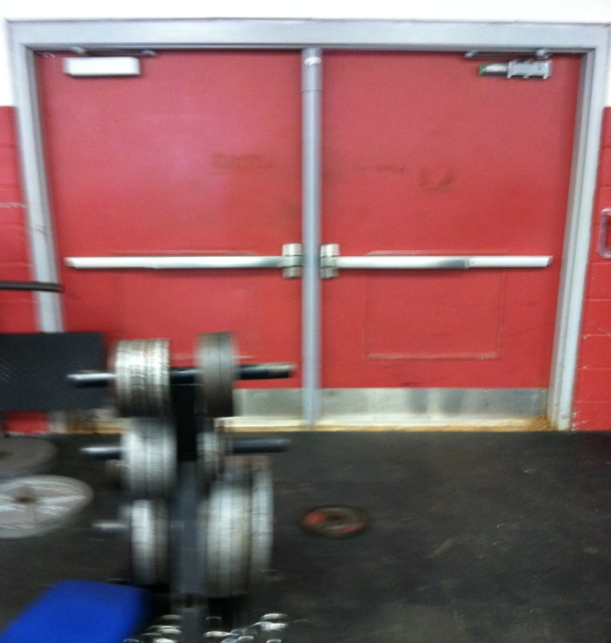
Over time the risk associated with behaviors fades and the entire culture and climate of the school becomes tolerant to risks despite policies, practices, procedures, technology, and programs.
Staff members are not choosing to put others in harm’s way; instead, they feel they are still being safe even as they engage in potentially unsafe behavior.
Experienced staff members are the ones most likely to commit a human error.
Notes:
Over time the risk associated with behaviors fades and the entire culture and climate of the school becomes tolerant to risks despite all of those things we do like practice drills and remind staff members about policies. We need to understand that staff members are not choosing to put others in harm’s way; instead, they feel they are still acting safely even as they engage in potentially unsafe behavior. We tend to rationalize our behavior. And listen to this, it almost seems counterintuitive, but research confirms that it’s the more experienced staff members who are the ones most likely to commit a human error, because they are more likely to rationalize that the odds are against something tragic happening. But keep in mind that there may be a combination of underlying causes requiring a combination of preventative measures. Why does this happen?

Slide 31
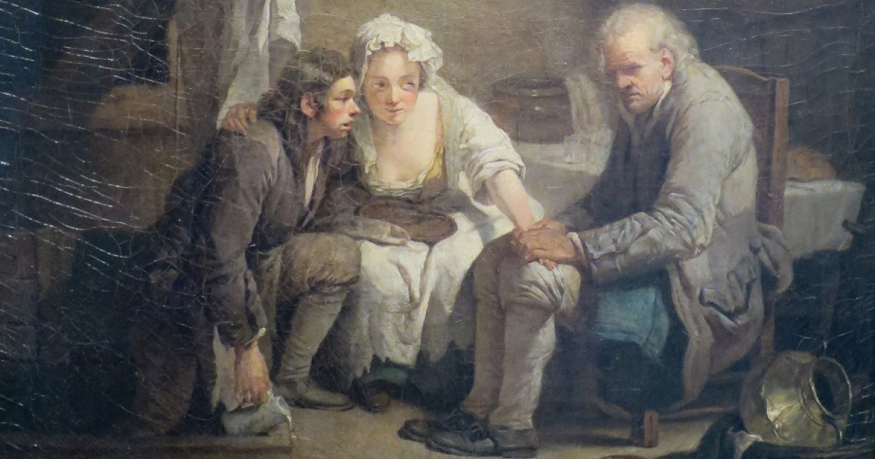
ANTON SYNDROME
Notes:
Why? Because we have blind spots. The Anton Syndrome is one of the reasons we don’t see the potential for human error. In the 1800s, a doctor found the case of a man who was injured at work and became blind, but he refused to accept the fact he was blind; he complained about the rooms always being dark and adamantly refused to believe that he was blind – a part of his brain in the occipital lobe could not process the fact that he was blind (30 documented cases since then) – in other words, he was blind to his blindness. Using that as an analogy: We all have blind spots in our knowledge and opinions, (click) which can blind us to our blindness. We are blind to our blind spots, which impairs our ability to recognize the potential for human error. And one of the primary causes of blind spots is attribution.

Slide 32
We are blind to our blindness!
ANTON SYNDROME
Notes:
I’m going to illustrate the main obstacle by using an analogy - it’s called the Anton Syndrome. The Anton Syndrome is one of the reasons we don’t see the potential for human error. In the 1800s, a doctor found the case of a man who was injured at work and became blind, but he refused to accept the fact he was blind; he complained about the rooms always being dark and adamantly refused to believe that he was blind – a part of his brain in the occipital lobe could not process the fact that he was blind (30 documented cases since then) – in other words, he was blind to his blindness. Using that as an analogy: We all have blind spots in our knowledge and opinions, (click) which can blind us to our blindness. We are blind to our blind spots, which impairs our ability to recognize the potential for human error. And one of the primary causes of blind spots is attribution.

Slide 33
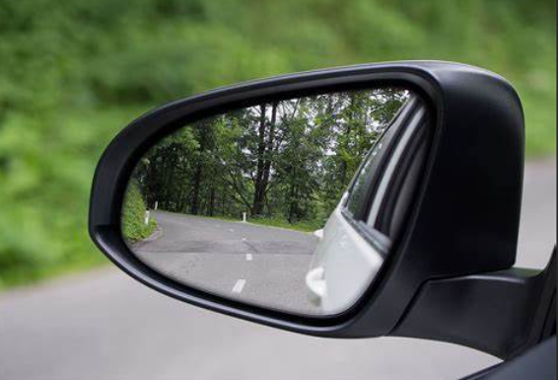
Accept
Anticipate
Aware
Human Error
Notes:
We are blind to our blind spots, but we can manage blind spots if we acknowledge them. We have blind spots but unless we accept, anticipate, and are aware that we have blind spots then human errors will occur. Each time you use your rearview mirror I want you to think about human error. I’m sorry I did that to you – to burden you with that memory hook – but now you will associate rearview mirrors and backup cameras with human error – to get you to overcome our blind spots.

Slide 34
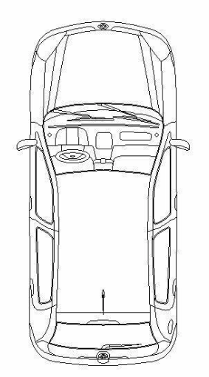
School Safety Plan
4 P’s (Policies, Practices, Procedures, Programs)
Human Error
Technology
Notes:
Think of it this way – adding huma error to address the blind spots along with technology, policies, practices, procedures, and programs. It’s another method that includes more precisely the human element of school safety.

Slide 35
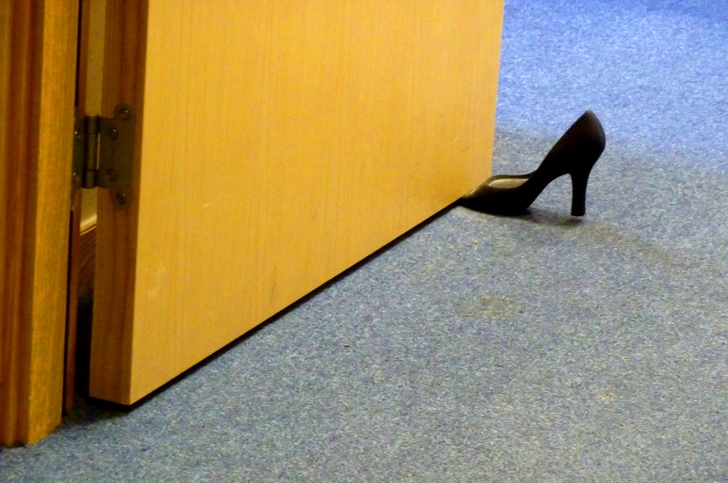
Over time when there are no incidents, the entire climate of the school can become tolerant of risks.
Risk Homeostasis
Notes:
But this is what we are up against. Over time when there are no school safety incidents, the entire climate of the school can become tolerant of risks. Individuals are not choosing to put others in harm’s way, like I said; instead, they feel they are still acting safely. And there is risk homeostasis where we rationalize the risk. I-16 You know what the speed limit is but you drive 79 instead of 70 even though you know the risk of accident and injury increases as you increase your speed.

Slide 36

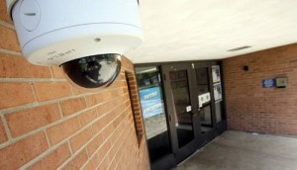
According to a study by RAND Corporation on the use of technology in schools, the researchers stated that there is a common concern that using technology in school safety initiatives can create a false sense of security.
Use technology to address blind spots not create them.
Notes:
Let me say a word of caution about technology. According to a study by RAND Corporation on the use of technology in schools, the researchers stated that there is a common concern that using technology in school safety initiatives can create a false sense of security.
In other words, use technology to address blind spots not create them.

Slide 37
Qualitative Analysis
Quantitative Analysis
Human Factors
School Climate
Layers of Protection Analysis (LOPA)
LOPA is a technique that links quantitative analysis with qualitative analysis. It is widely used in several industries for assessing hazardous scenarios and supporting danger-identification by on-going assessments.
LOPA provides a balance between the practicality of qualitative analysis and the detail of quantitative analysis that blend technology with human behavior.
Notes:
So, to avoid human errors that might jeopardize your safety technology, consider the Layers of Protection Analysis or LOPA technique. LOPA is a technique that links quantitative analysis (the techy stuff) with qualitative analysis (the human stuff). In other words if the techy stuff does contain like it shows here what we observe, qualitative, what factors derive from human behavior and the interaction between human behavior and its environment, as well as factors embedded in school culture and climate, then our school safety technology will fall short of our needs and expectations. LOPA It is widely used in several industries for assessing hazardous scenarios and supporting danger-identification by on-going assessments.

Slide 38
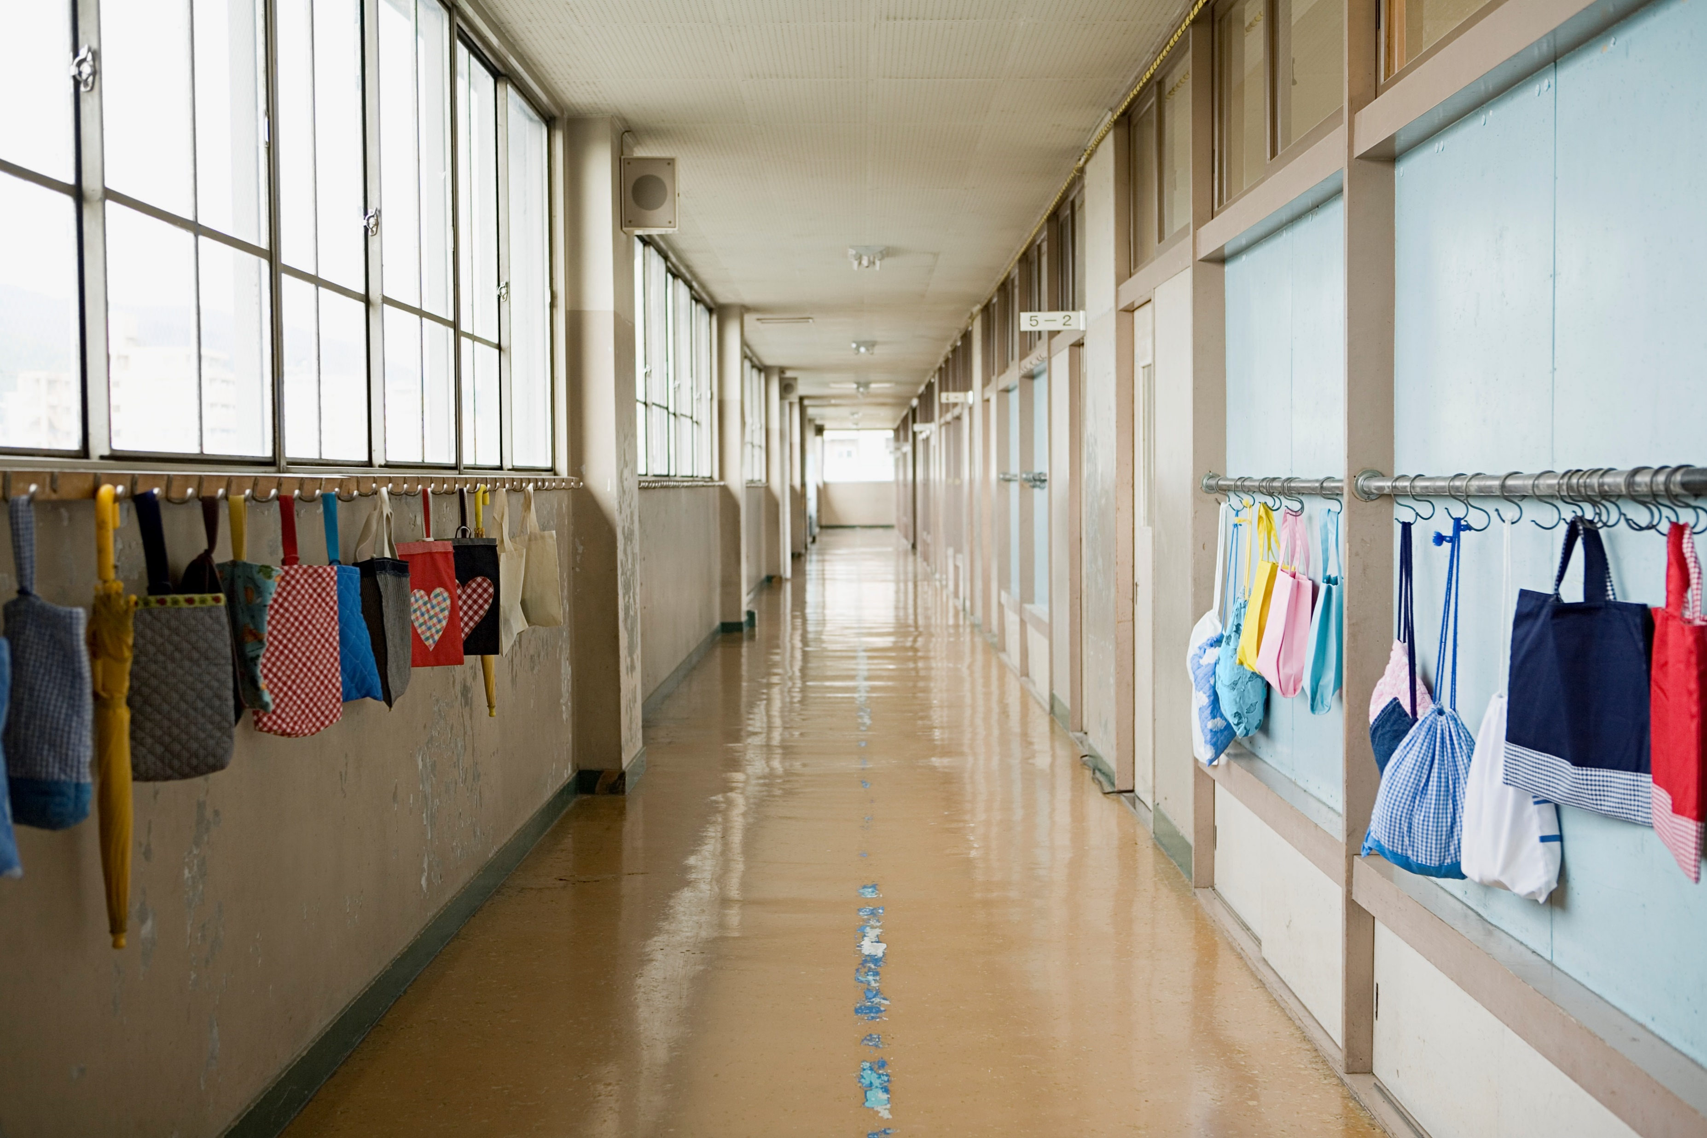
Think differently about school climate to prevent human errors.
School climate is linked to school safety and human errors.
“School climate is unquestionably linked to school safety.” –SchoolSafety.Gov.
According to a RAND study, school climate is the only school characteristic that consistently correlates with school violence.s.
Notes:
And speaking of climate of a school. As part of considering human error to address our blind spots, don’t forget the importance of school climate. School climate is linked to school safety and human errors. The risk of human errors is increased within a negative school climate. A negative school climate can compromise safety by dulling anticipation and alertness – To put it another way, negative school climate is an incubator for human error.

Slide 39
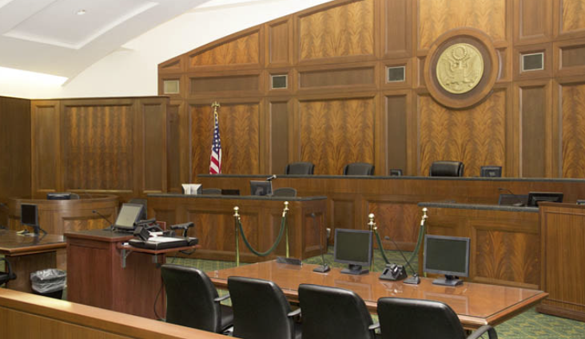
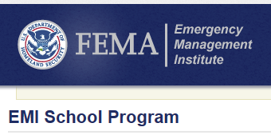

Notes:
To further illustrate the importance of school climate, FEMA, REMS, and others include school climate in their school safety training sessions for schools, and in court cases…As I said earlier, I’ve testified in juvenile court, state court, superior court, and federal court. I’ve given so many depositions I can’t keep track of how many and do you know what I’m asked the most about? No, not policies, procedures, or practices – it’s mostly about school climate. Attorneys want to know what is it like to work in a school – what is the climate like there? Recently, my doorbell rang at my home on a Saturday….the main point being that school climate impacts human error. 7 hour deposition – safety is linked to school climate. Don’t let school climate be a blind spot. Don’t take school climate for granted. It’s part of your Tiered approach to student services AND school safety.

Slide 40

Is human error predictable?
Just because it seems like something has become safer doesn’t mean the risk hasn’t transferred somewhere else.
Notes:
By now, you’re probably wondering if human error is predictable or can we at least anticipate human errors.

Slide 41

Human Error
Seven-Step Process
(HESSP)
Anticipating and predicting human error
Notes:
There are ways to predict or anticipate human error or the possibility of human error. One of which is The Human Error 7-Step Process. It is an example of a process schools and school districts can use to anticipate and even predict human error. This has been used in schools. I used it recently with a school and they found 17 places within their School Safety Plan that was susceptible to human errors and they adjusted their staff training around those factors, which led to a rich discussion about how human behavior intersects with policies, practices, procedures, and programs. That’s the primary purpose is staff training on human error.

Slide 42
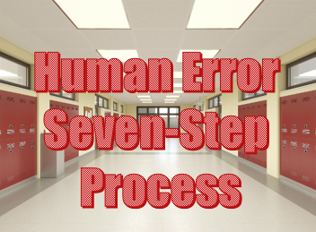
Based on the process thinking that includes awareness of types of human error and attributions that can influence them combined with our understanding of the importance of looking for patterns and clues and searching for basic problems using lateral thinking, the Human Error Seven-Step-Process (HESSP) is an example of a process that can be used to predict or anticipate human error in PK-12 schools.
Notes:
Based on the process thinking that includes awareness of types of human error and biases that can influence them combined with our understanding of the importance of looking for patterns and clues and searching for basic problems using lateral thinking, Human Error Seven-Step-Process (HESSP) is an example of a process that can be used to predict or anticipate human error in PK-12 schools.

Slide 43
Step 1: Identify section of a plan, policy, procedure, practice, and program being reviewed.
Step 2: Identify possible human errors of concern in each section.
Step 3: Identify human errors of concern based on conditions, including how and what conditions would increase the likelihood of human errors.
Step 4: Identify how the human error would impact the safety of students, employees, and/or integrity, reliability, and efficiency of school district operations.
Step 5: Identify how the response to an emergency could be compromised by human error.
Step 6: On a scale of 1-5 (unlikely to likely) determine how likely human error is to occur in each part of the plan, policy, practice, and program (and use rating to measure improvements).
Step 7: Identify methods and strategies to prevent human error in the identified area of concern and under conditions that could increase the likelihood and consequences of human error.
Notes:
Step 1: Identify section of a plan, policy, procedure, practice, and program being reviewed.
Step 2: Identify possible human errors of concern in each section.
Step 3: Identify human errors of concern based on conditions, including how and what conditions would increase the likelihood of human errors.
Step 4: Identify how the human error would impact the safety of students, employees, and/or integrity, reliability, and efficiency of school district operations. Step 5: Identify how the response to an emergency could be compromised by human error.
Step 6: On a scale of 1-5 (unlikely to likely) determine how likely human error is to occur in each part of the plan, policy, practice, and program (and use rating to measure improvements).
Step 7: Identify methods and strategies to prevent human error in the identified area of concern and under conditions that could increase the likelihood and consequences of human error.

Slide 44
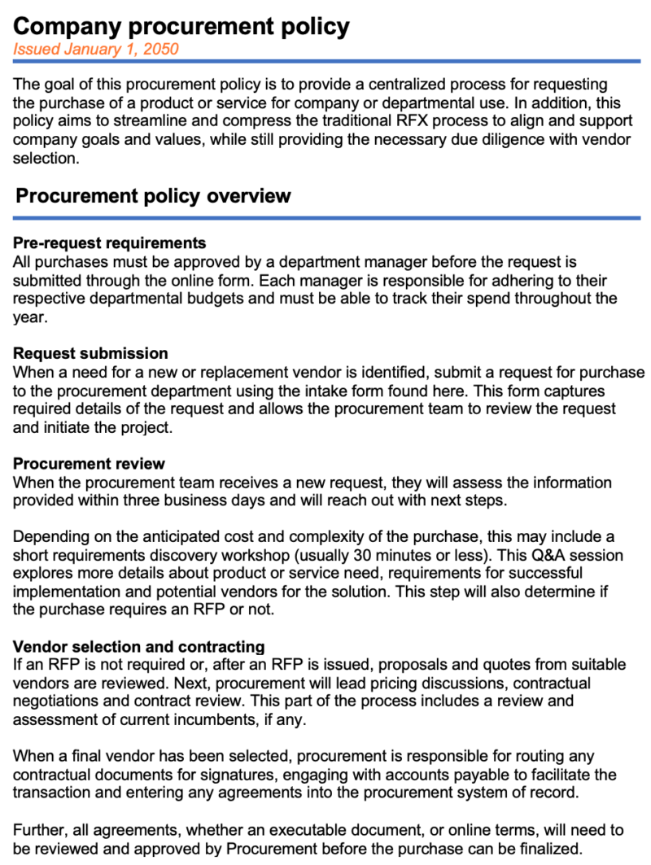
Step 1: Identify section of a plan, policy, procedure, practice, and program being reviewed.
Step 2: Identify possible human errors of concern in each section.
Step 3: Identify human errors of concern based on conditions, including how and what conditions would increase the likelihood of human errors.
Step 4: Identify how the human error would impact the safety of students, employees, and/or integrity, reliability, and efficiency of school district operations.
Step 5: Identify how the response to an emergency could be compromised by human error.
Step 6: On a scale of 1-5 (unlikely to likely) determine how likely human error is to occur in each part of the plan, policy, practice, and program (and use rating to measure improvements).
Step 7: Identify methods and strategies to prevent human error in the identified area of concern and under conditions that could increase the likelihood and consequences of human error.
Notes:
It’s being used in areas such as procurement where human errors are becoming too common.

Slide 45

Step 1: Identify section of a plan, policy, procedure, practice, and program being reviewed.
Step 2: Identify possible human errors of concern in each section.
Step 3: Identify human errors of concern based on conditions, including how and what conditions would increase the likelihood of human errors.
Step 4: Identify how the human error would impact the safety of students, employees, and/or integrity, reliability, and efficiency of school district operations.
Step 5: Identify how the response to an emergency could be compromised by human error.
Step 6: On a scale of 1-5 (unlikely to likely) determine how likely human error is to occur in each part of the plan, policy, practice, and program (and use rating to measure improvements).
Step 7: Identify methods and strategies to prevent human error in the identified area of concern and under conditions that could increase the likelihood and consequences of human error.
Notes:
Some Human Resources Departments are applying the 7 steps to review their manual – to make staff aware of the potential for human error.

Slide 46


Step 1: Identify section of a plan, policy, procedure, practice, and program being reviewed.
Step 2: Identify possible human errors of concern in each section.
Step 3: Identify human errors of concern based on conditions, including how and what conditions would increase the likelihood of human errors.
Step 4: Identify how the human error would impact the safety of students, employees, and/or integrity, reliability, and efficiency of school district operations.
Step 5: Identify how the response to an emergency could be compromised by human error.
Step 6: On a scale of 1-5 (unlikely to likely) determine how likely human error is to occur in each part of the plan, policy, practice, and program (and use rating to measure improvements).
Step 7: Identify methods and strategies to prevent human error in the identified area of concern and under conditions that could increase the likelihood and consequences of human error.
School Facilities Manual
Notes:
So, you can do the same with your facilities manuals. I recently did training for school facility directors on human error – in fact the top 15 facility related human errors – like this (click)

Slide 47

Step 1: Identify section of a plan, policy, procedure, practice, and program being reviewed.
Step 2: Identify possible human errors of concern in each section.
Step 3: Identify human errors of concern based on conditions, including how and what conditions would increase the likelihood of human errors.
Step 4: Identify how the human error would impact the safety of students, employees, and/or integrity, reliability, and efficiency of school district operations.
Step 5: Identify how the response to an emergency could be compromised by human error.
Step 6: On a scale of 1-5 (unlikely to likely) determine how likely human error is to occur in each part of the plan, policy, practice, and program (and use rating to measure improvements).
Step 7: Identify methods and strategies to prevent human error in the identified area of concern and under conditions that could increase the likelihood and consequences of human error.
Notes:
Some schools are using the Seven-Process to identify potential for human error in each section of their safety manuals, EOPs, COOPs and School Safety Plans. I was at a school recently that during a faculty meeting had the teachers and others look through their School Safety Plan and identify what areas the faculty thought might be susceptible to human error, and then they talked about awareness and prevention. The faculty identified 11 places that were prone to human error and that became part of the staff training.

Slide 48

Human Error
Awareness Rating
(HEAR)
BASED ON THE MOST COMMON TYPES OF HUMAN ERROR
Notes:
Let me also show you quickly another method schools can use to anticipate human error. This model is based on an algorithem calculation used in other professions to predict or anticipate human error. It is referred to as the Human Error Awareness Rating (HEAR). It can be used to heighten awareness of the possibility of human error in our schools, colleges, and universities and therefore prevent human error and can be embedded in the work you do in schools OR you can develop your own version. You’re free to use this version and the 7-Step Process or you can use thems as an example or model and develop your own.

Slide 49
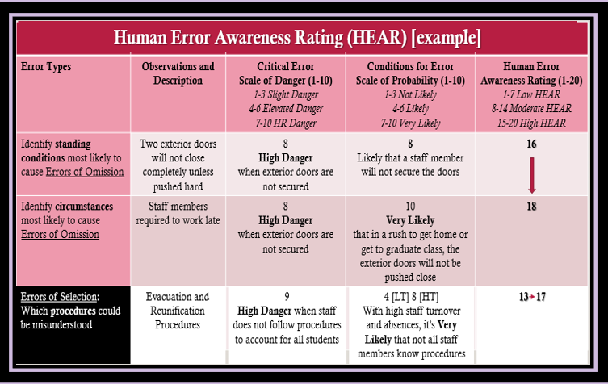
Human Error
Awareness Rating
(HEAR)
Notes:
And here’s one that’s filled in, and you can see that it creates a nexus of error type, observation, Critical Error rating, Conditions for Error rating, and then a human error awareness rating, with the goal being you want to get that awareness rating reduced before something happens. It can be used for a debriefing, but’s focus on preventing human error and a way of measuring progress toward reducing human error by reducing that scale rate of probability. The point is you can use these free processes to determine the probability of human error or more importantly you can create your own.

Slide 50

Human Error
RESOURCES
REMS Human Error
Notes:
As I close, there are resources – you can have a copy of today’s PPT, you can request the half-day or full-day HE training, and/or you can go the REMS website – in any browser just type REMS and human error and it will take you this (click) website.

Slide 51
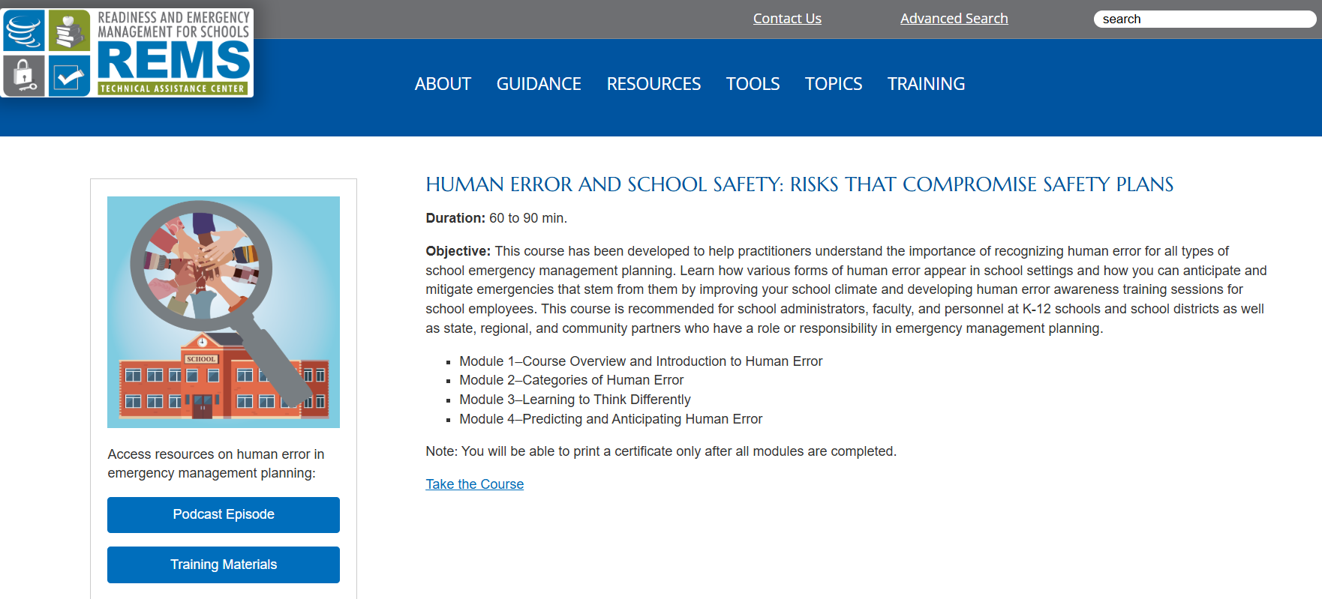
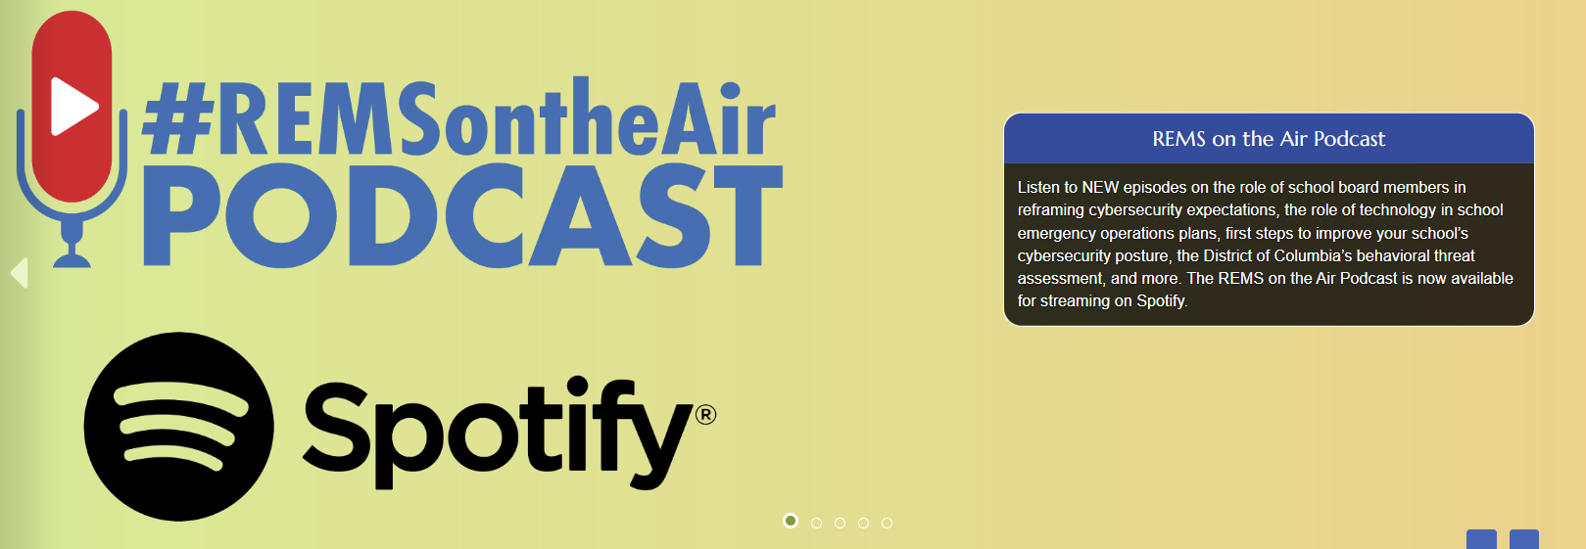
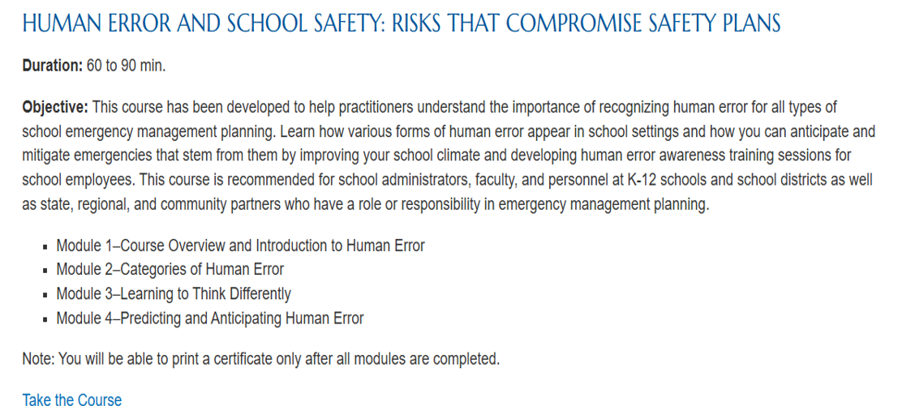
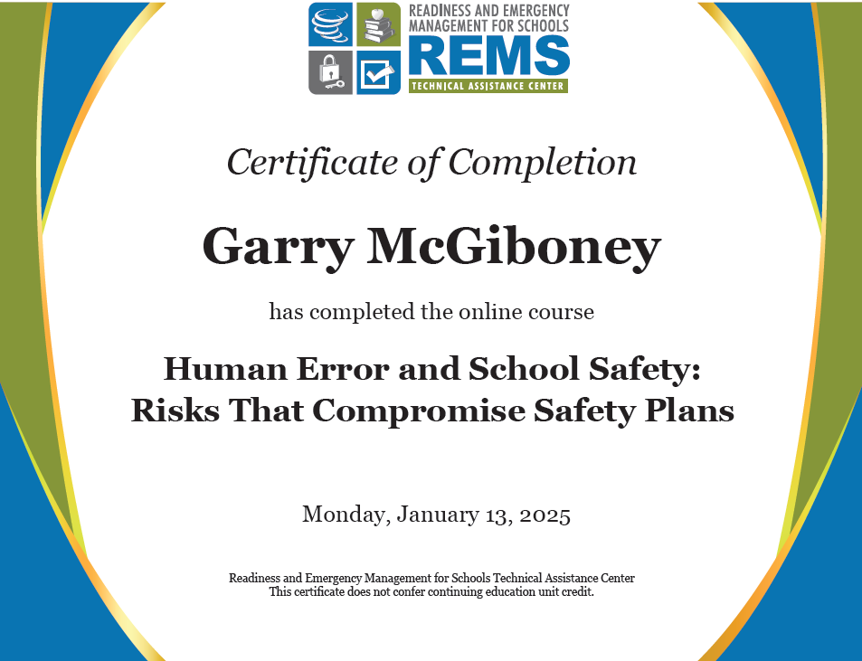
RESOURCES TO
SUPPORT YOUR WORK
rems.ed.gov
Take the Course
Notes:
US Dept. of Ed REMS recently published my online course on human error. It’s narrated and has interactive features and formative assessments embedded in the course. And participants receive a certificate upon completing the course which takes about 60-70 minutes. It can be taken individual or in a group setting. Some school districts are requiring employees to take the online course.

Slide 52

RESOURCES TO
SUPPORT YOUR WORK
REMS PODCAST
HUMAN ERROR
Notes:
US Dept. of Ed REMS website includes a podcast on Human Error with me answering questions about human error.

Slide 53
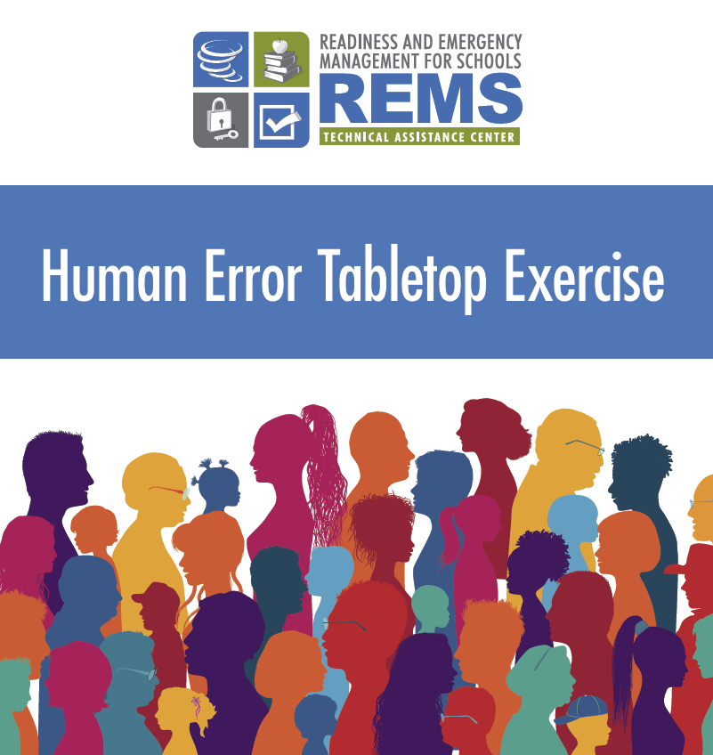
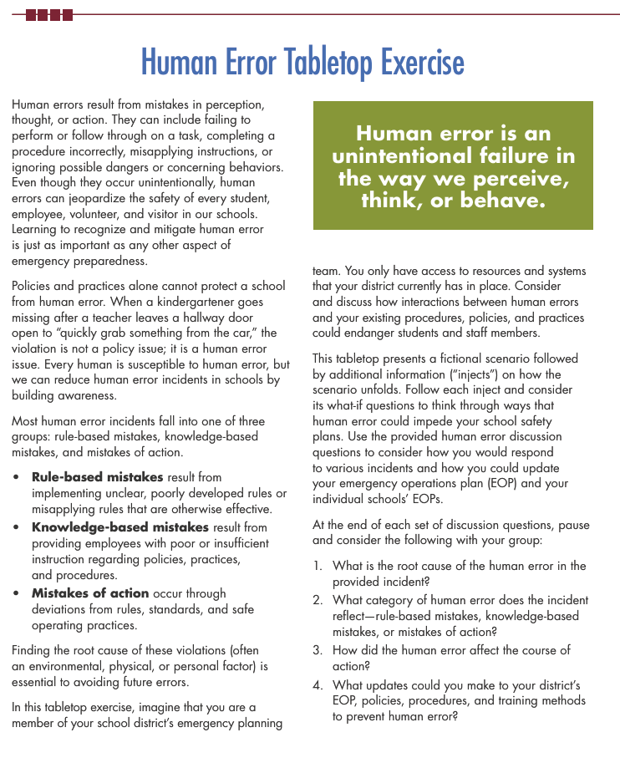
RESOURCES TO
SUPPORT YOUR WORK
rems.ed.gov
Notes:
I also created a human error tabletop exercise that the US Dept. of Ed REMS has published and released as you see here.

Slide 54
Human Error
is closer than it appears
Changing the School Safety Paradigm
Garry W. McGiboney, Ph.D.
Garry.McGiboney@healthsecuritydynamics.com Phone/text: 404-664-3286
Notes:
As I close, let me encourage each of you to create a mechanism or a plan within a comprehensive safety strategy that includes the possibility of human error. As you will hear from the next speakers, Chief Kogod and Chief Rosa – we must change the school safety paradigm – please include human error in your school safety planning because human error is closer that it appears.

