Slide 1
INTRODUCTION TO
GASROE SCHOOL SAFETY SERIES
2025 GSSA BOOTSTRAPS
WWW.GASROE.ORG

Slide 2
PRESENTERS:
MURRAY KOGOD
HABERSHAM COUNTY DIRECTOR OF SCHOOL SAFETY/CHIEF OF POLICE & GASROE EXECUTIVE DIRECTOR
DANIELLE ROSA
COWETA COUNTY SCHOOLS
DIRECTOR OF SAFETY & GASROE PRESIDENT

Slide 3
The History of GASROE
Since its inception, GASROE has developed collaborative relationships that have raised the bar when it comes to school safety efforts in the State of Georgia. Collaborative partners include:
PLUS…
City Police Departments, Board of Education Police
Departments, Sheriff’s Offices, and School
Districts throughout the state.

Slide 4
GASROE SCHOOL SAFETY SERIES - PRESENT
WHAT’S INCLUDED...
GASROE Triad Methodology School-Based Policing Model (Sets the foundation for the SRO and Admin Relationship.)
GASROE School Safety Toolkit (UPDATED)
GASROE School-Based Policing Starter Kit (NEW)
GASROE S.A.F.E.R. Assessment (NEW)
GASROE Certifications
GASROE Regional Trainings

Slide 5
The Challenge
Opponents argue that law enforcement’s presence in the schools, and their inherent training to detect crime and arrest those that commit crimes, heightens the chance of students entering the pipeline to prison.
In some ways, WE AGREE.

Slide 6
THE TRUTH...
THE TRUTH ABOUT SCHOOL IS...IT IS THE TRAINING GROUND FOR LIFE.
THE ULTIMATE GOAL OF A SCHOOL SYSTEM IS TO SEE STUDENTS SUCCEED THROUGH GRADUATION AND BEYOND.

Slide 7
The Question
How do we effectively integrate law enforcement into the academic environment?

Slide 8
The GASROE TRIAD MODEL
The Foundation of School Safety
WWW.GASROE.ORG

Slide 9
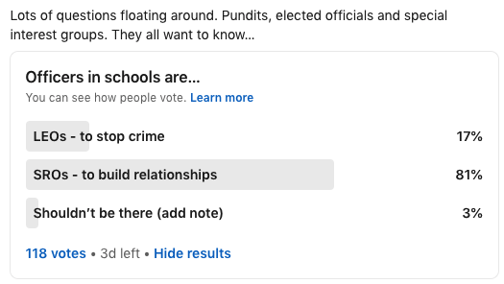
IT STARTS WITH THE RELATIONSHIP
THE TRIAD SCHOOL-BASED POLICING MODEL
A Peace Officer who is more than just a prevention mechanism via their presence at the school.
A Peace Officer who understands the attitude, mission and goals of the school administration and works with them to see students succeed.

Slide 10
THE TRIAD METHODOLOGY
Methodology
No LEO’s in Schools; Just SRO’s
Mindset
Requires the SRO to view his or her role at the school differently
FOCUSES ON
2 ASPECTS
THE POLICE OFFICER
THE SCHOOL RESOURCE OFFICER
Proactively looking for the citizen doing wrong.
Focuses on the Enforcer aspect of law enforcement.
Loves to “Get into Something”.
The “Cuff Them and Stuff Them” mentality.
Wants to put people in Jail.
The Enforcer becomes the Protector.
Sees beyond the “cuff them and stuff them” mentality.
Wants to work with school administration to utilize a student-centered focus and to change behavior through restorative practices.
The criminal justice process is a last resort rather than a first thought.

Slide 11
THE TRIAD SCHOOL-BASED POLICING MODEL
FOCUSES ON 2 ASPECTS
Methodology
No LEO’s in Schools; Just SRO’s
Mindset
Requires the SRO to view his or her role at the school differently
GASROE TRIAD APPROACH HAS BEEN RECOGNIZED AT LOCAL
AND NATIONAL LEVELS

Slide 12
The School Climate Approach
Implementing a learning environment that addresses both physical safety measures and behavioral health services wherein students , faculty, and staff feel physically secure and emotionally supported.

Slide 13
The GASROE School Safety Toolkit
Best Practices in Keeping your Schools Safe
WWW.GASROE.ORG

Slide 14
THE SCHOOL SAFETY TOOLKIT
BOARD ACTION
BOE Resolutions
Goals and Objectives
NEW INTIATIVES
Teaching Our Youth Safety (T.O.Y.S.) in Schools
GASROE G.R.I.T.
S.A.V.E. Anti-Vaping Campaign
TRAINING
Bridging the Gap - For Culturally and Linguistically Diverse Students and Families
School Safety Facilitated PowerPoint Trainings
Monthly Safety Scenarios
District Safety Team Tabletop Exercise Planning
SRO Evaluation Rubric
Situational Awareness Training for Faculty and Staff
ANNUAL SAFETY MEASURES
Emergency Drill Schedule and Reporting
School Safety Plans and Filing Requirements
Critical Incident Response Team (C.I.R.T.) Assignments
Daily Door Check Plan/SCHOOLDOG
Safe School Site Assessment Checklist
Student Threat Assessments
Safety Signage
Large Scale Event Safety Planning

Slide 15
THE SCHOOL SAFETY TOOLKIT
SAMPLE DOCUMENTS AND TEMPLATES INCLUDED
BOE Resolutions
District School Safety Program
Behavioral Threat Assessment
Goals and Objectives Worksheet
School District New Initiatives
T.O.Y.S in Schools
S.A.V.,E. Anti-Vaping Campaign
GASROE G.R.I.T.
Emergency Drill Reporting Schedule Form
Critical Incident Response Team (C.R.I.T.) Assignments
Safe School Site Assessment Checklist
SCHOOL SAFETY PLANS AND FILING REQUIREMENTS
GASROE SCHOOL SAFETY Plan Template
GASROE SAFE SCHOOLS Plan Template
District Safety Team Table Top Scenarios
Monthly Safety Scenarios
Action Plans for Large Events
Daily Door Check Plan

Slide 16
The GASROE SAFER Assessment
Protecting the School Learning Environment
WWW.GASROE.ORG

Slide 18
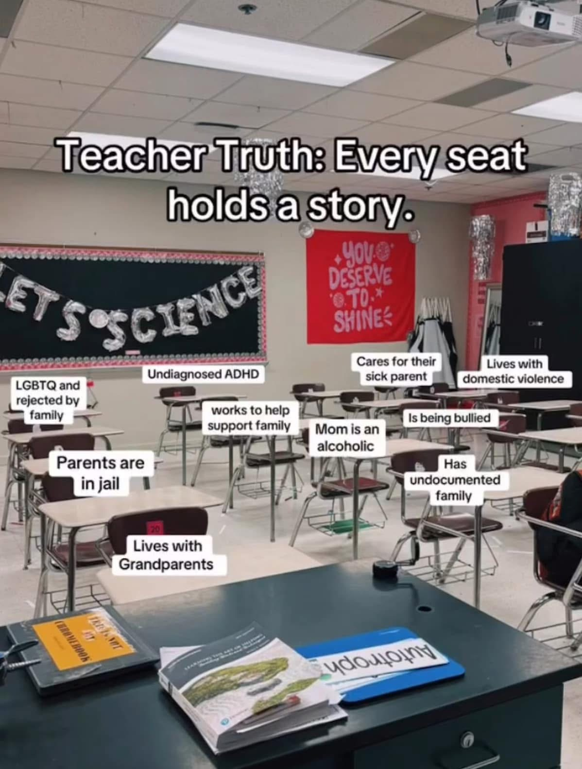
Behavioral Threat Assessments
In many cases, it is MUCH more than just a behavioral issue.

Slide 19
GASROE STUDENT ASSESSMENT FOR EDUCATIONAL REINTEGRATION
SCHOOL SAFETY BEHAVIORAL THREAT ASSESSMENTS - GASROE NEW INITIATIVE 2025
ASSESSING STUDENTS OF CONCERN
Learn effective strategies for identifying and supporting students of concern to ensure they receive the services they need for positive and safe reintegration into the educational environment. This training emphasizes ongoing support to promote a successful and sustained educational experience.
SCHOOL THREATS - EARLY DETECTION AND TEAM INTERVENTION THROUGH THE GASROE SAFER ASSESSMENT MODEL APPROACH:
ESTABLISING A TEAM
MEETINGS & RESPONSIBILITIES
DOCUMENTATION & REPORTING
CONDUCTING AN ASSESSMENT
ACCESS TO WEAPONS
IEP/504 PLANS
COUNSELING
FAMILY SERVICES
ALTERNATIVE SCHOOL
THE SAFETY INTERVENTION PLAN

Slide 20
So Why GASROE Training?
GASROE is a network of school safety professionals actively working within the educational environment. Committed to sharing best practices in school safety, we continuously offer updated conferences and training sessions designed to equip all school safety personnel — including SROs, administrators, educators, school safety directors/coordinators, counselors, and coaches — with the knowledge and skills necessary to protect our most valuable asset; OUR YOUTH!
Together, we’re creating safer learning environments and shaping a more secure future for our communities.
#WeAreGASROE

Slide 21
GASROE SCHOOL SAFETY SERIES
SATISFIES ALL THE GUIDLINES SET FORTH BY...
HB 147
HB 268

Slide 22
2025 GS3 SCHOOL SAFETY CONFERENCE
JUNE 2ND-5TH, 2025
DOWNLOAD OUR APP!
Join us for 3 days of hands-on and in-person school safety training in Columbus, Ga at the Columbus Ga. Convention and Trade Center
Stay up to date on our latest training and school safety intel vital for school safety!

Slide 23
THANK YOU!
CONTACT INFORMATION
DANIELLE ROSA @ (770) 355-0541
MURRAY KOGOD @ (404) 787-2982
SEE YOU AT THE SUMMER CONFERENCE !

